Slide 1
Current Sheets in the Solar Wind: JUNO and PSP Observations
Zijin Zhang
Anton V. Artemyev
Vassilis Angelopoulos

Slide 2
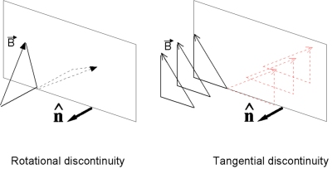
Current Sheets (AKA Solar wind discontinuities)
Discontinuous changes in plasmas parameters and magnetic fields
Import element of solar wind turbulences. Borovsky (2010)
Very kinetic structure:
Jumps in the electron density, temperature and pitch angle distribution. Artemyev et al. (2019)
Confucius Colburn et al., 1966
Notes:
Magnetohydrodynamics theory: classified as rotational discontinuities (RD), tangential discontinuities (TD), and shock waves
We are interested in solar wind discontinuities because they are an import element of solar wind turbulences….
There is one result from Borovsky paper
The strong discontinuities produce a power-law spectrum in the “inertial subrange” with a spectral index near the Kolmogorov −5/3 index. The discontinuity spectrum contains about half of the power of the full solar-wind magnetic field over this “inertial subrange.”
From another point of view, SWD are a type of very kinetic structure. Which means that they can interact with the energetic part of the solar wind ions.

Slide 3
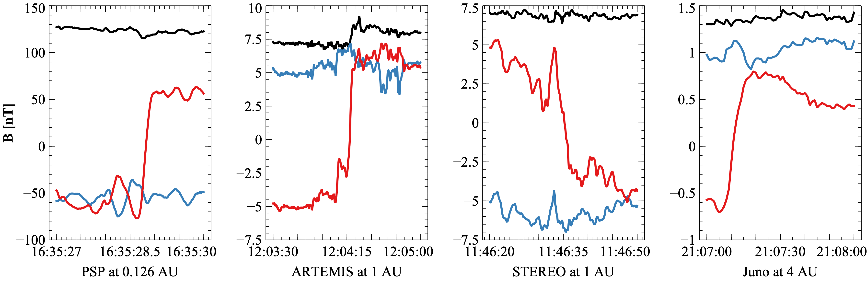
Examples of discontinuities

Slide 4
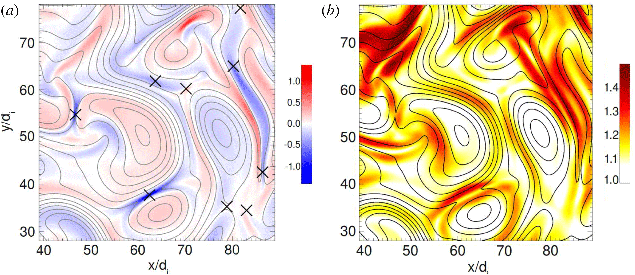
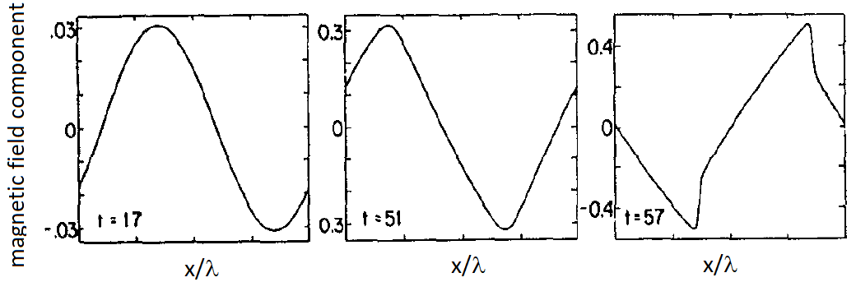
Formation of SWD
Turbulent ion heating by reconnection of tangential discontinuities. (a) Current density (color) and magnetic field lines, possible reconnection sites are indicated by crosses. (b) The proton temperature anisotropy (color) that indicates acceleration
Servidio et al., 2012 PRL
Alfven wave
discontinuities
Alfven wave steepening results in the discontinuity formation: magnetic energy transport from large scale (Alfven waves generated in the solar corona) to small (ion kinetic) scales of discontinuities, where this energy can be dissipated to particle heating
Malkov et al., 1991 PoP
Notes:
Solar wind discontinuities are generated as boundaries of plasma flows with different properties (Servidio et al. 2011a, 2011b) or result from the nonlinear evolution of Alfvén waves (Medvedev et al. 1997a, 1997b; Vasquez & Hollweg 1999, 2001).
The initial condition consists of a Maxwellian plasma perturbed by a 2D spectrum of Fourier modes, imposed for both the velocity and the magnetic field.
As represented in Fig. 1(a), turbulence manifests through the appearance of coherent structures, exhibiting a sea of vortices (islands) and current sheets….
These patterns of non-Maxwellian features are concentrated in space nearby regions of strong magnetic activity: the distribution function is modulated by the magnetic topology, and can elongate along or across the local magnetic field.
Using direct numerical simulations of a hybrid Vlasov-Maxwell model, kinetic processes are investigated in a two-dimensional turbulent plasma. In the turbulent regime, kinetic effects manifest through a deformation of the ion distribution function. These patterns of non-Maxwellian features are concentrated in space nearby regions of strong magnetic activity: the distribution function is modulated by the magnetic topology, and can elongate along or across the local magnetic field. These results open a new path on the study of kinetic processes such as heating, particle acceleration, and temperature anisotropy, commonly observed in astrophysical and laboratory plasma

Slide 5
Motivation
Studying the radial evolution of solar wind discontinuities from observations of PSP (0.1 AU – 1 AU) and JUNO (1AU – 5AU) with Earth-orbiting missions (ARTEMIS, Wind.
How does the discontinuities change with the radial distance from the Sun?
How is solar wind discontinuities formed? What is the physical mechanisms?
Generated at or near the sun?
Locally generated in the interplanetary space by turbulence?

Slide 6
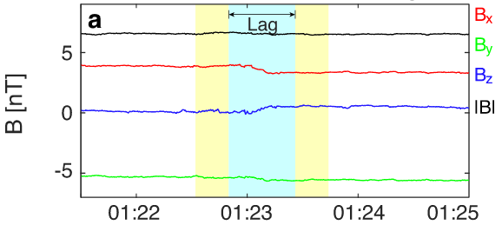
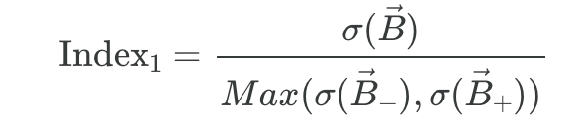
Identification/Detection method
Liu, 2022
Compared with adjacent intervals without sampling

Slide 7
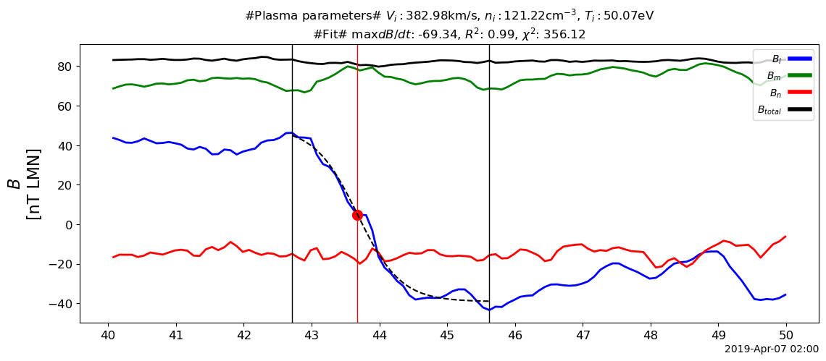
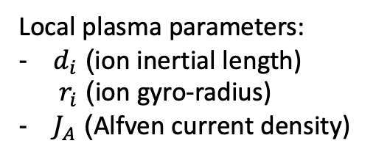
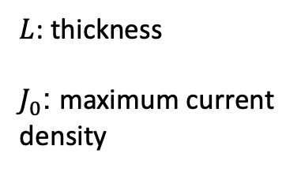
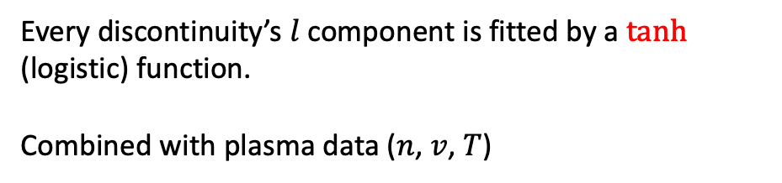
Properties of discontinuities
$L$: thickness
$J_{0}$: maximum current density
Every discontinuity’s $l$ component is fitted by a $tanh$ (logistic) function.
Combined with plasma data ($n$, $v$, $T$)
Local plasma parameters:
$d_{i}$ (ion inertial length) $r_{i}$ (ion gyro-radius)
$J_{A}$ (Alfven current density)

Slide 8
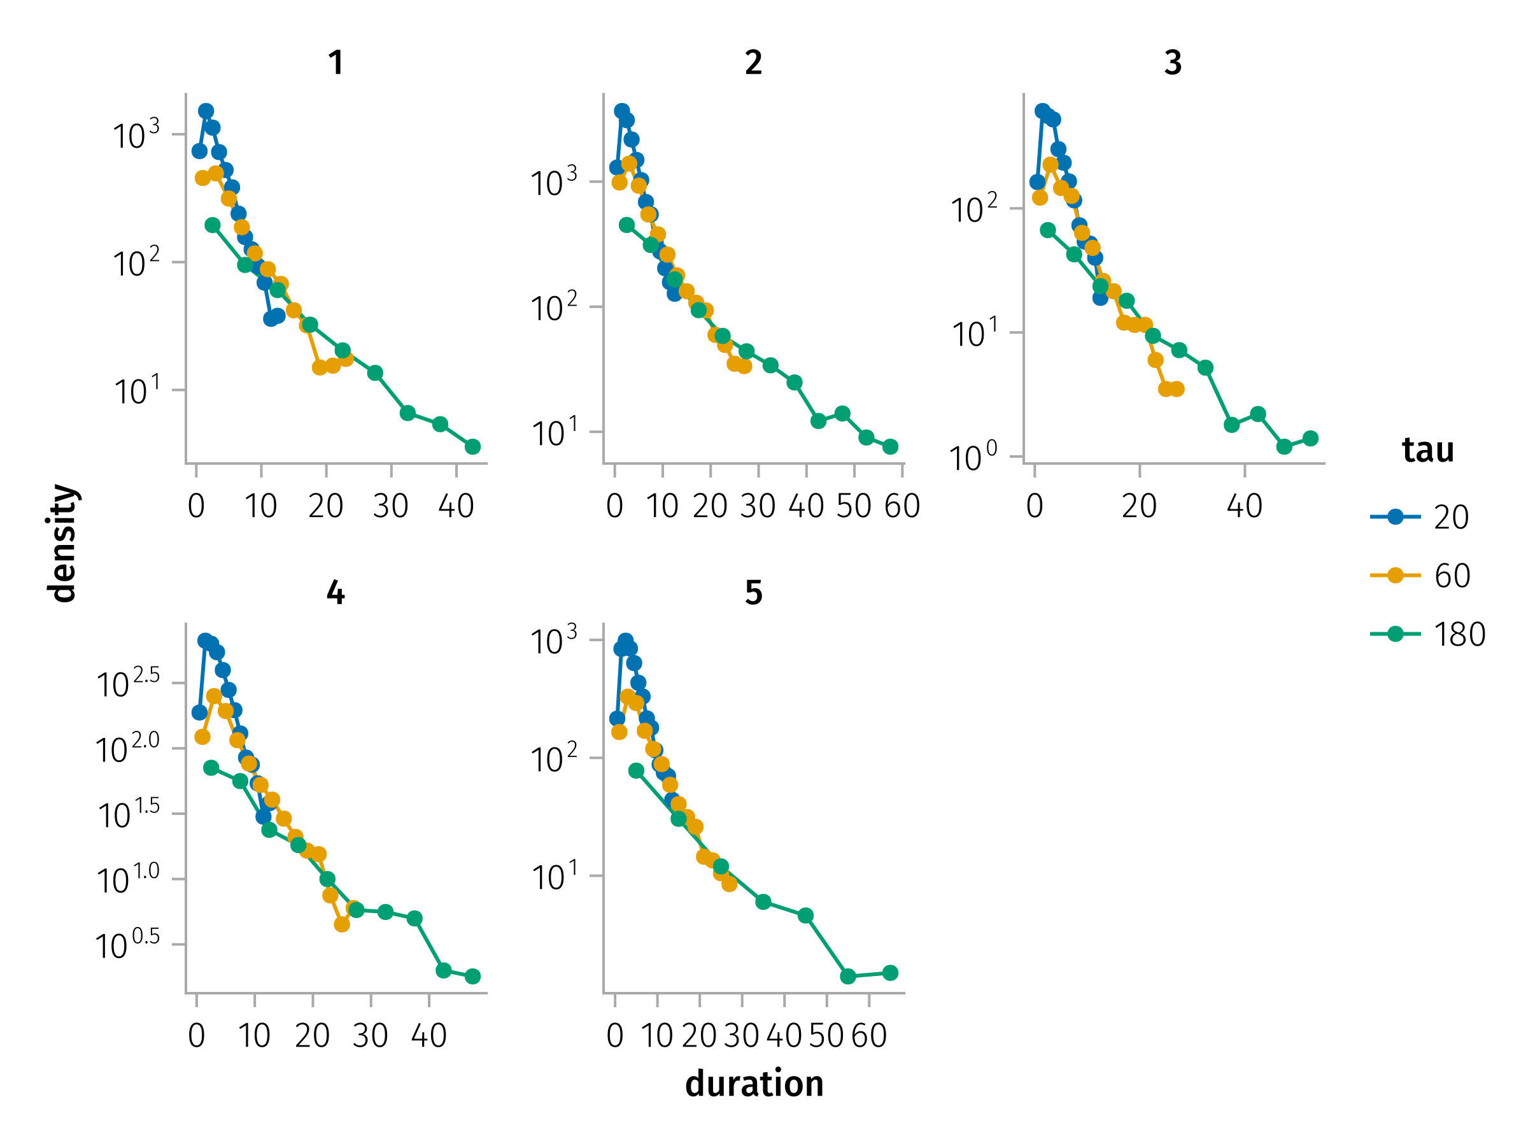
Identification method (continued)
Time resolution effect
Tau effect

Slide 9

JUNO Observations in the Outer Heliosphere
Part One

Slide 10
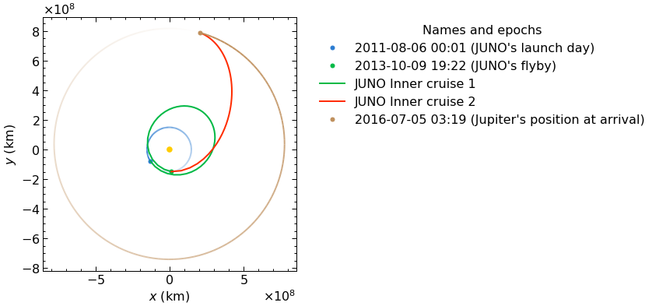
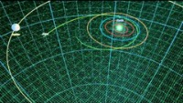
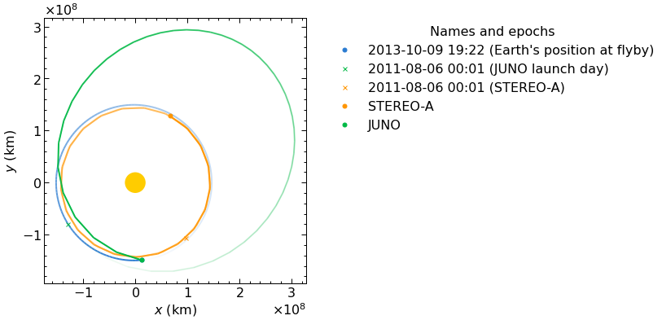
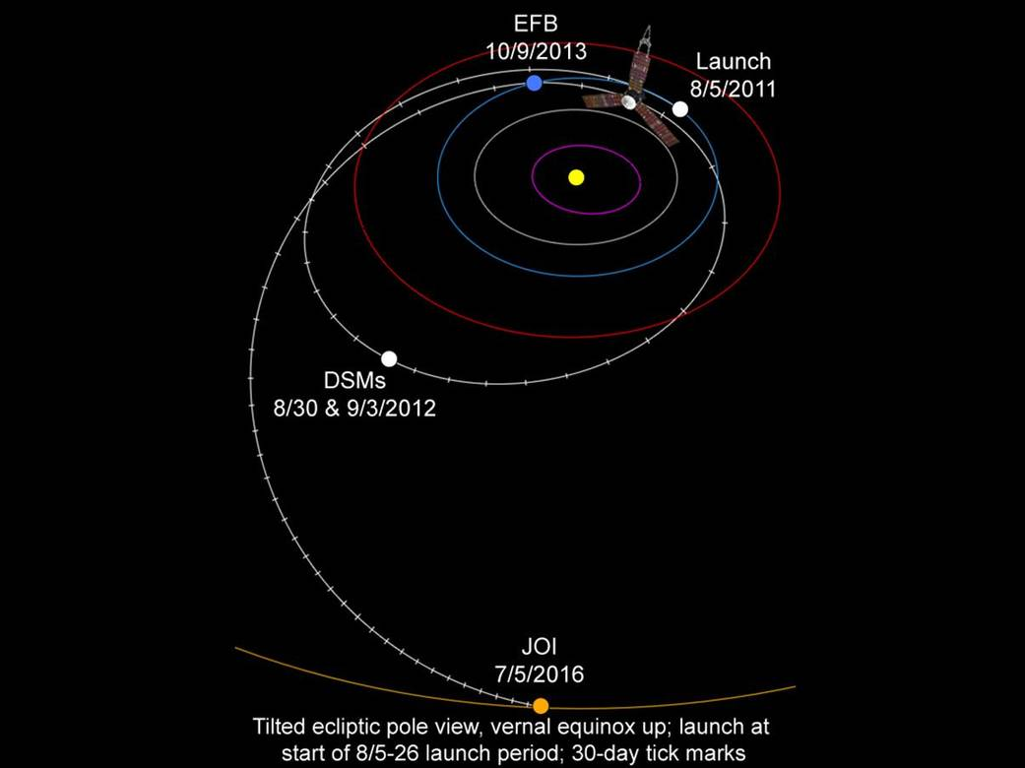
Juno Orbit
- Five-year cruise to Jupiter from 2011 to 2016
- One earth flyby in 2013
- Nearly the same Heliographic latitude as Earth

Slide 11
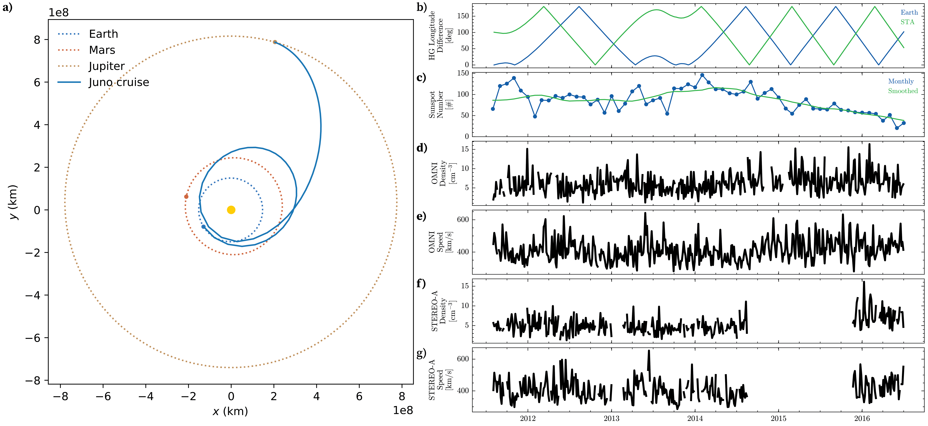
Overview
Figure 2: Overview. a, Juno’s orbit during its cruise phase (2011-2016). b, Difference in heliographic longitude between Juno and 1-AU missions. c, monthly and smoothed sunspot numbers.
Notes:
During the initial phase of the JUNO mission, the sunspot number reached its peak, indicating a period of heightened solar activity. However, by the end of the mission’s cruise phase, there was a significant decline in solar activity. This variation underscores the importance of calibrating the discontinuity properties in relation to solar activity levels to account for temporal fluctuations.

Slide 12
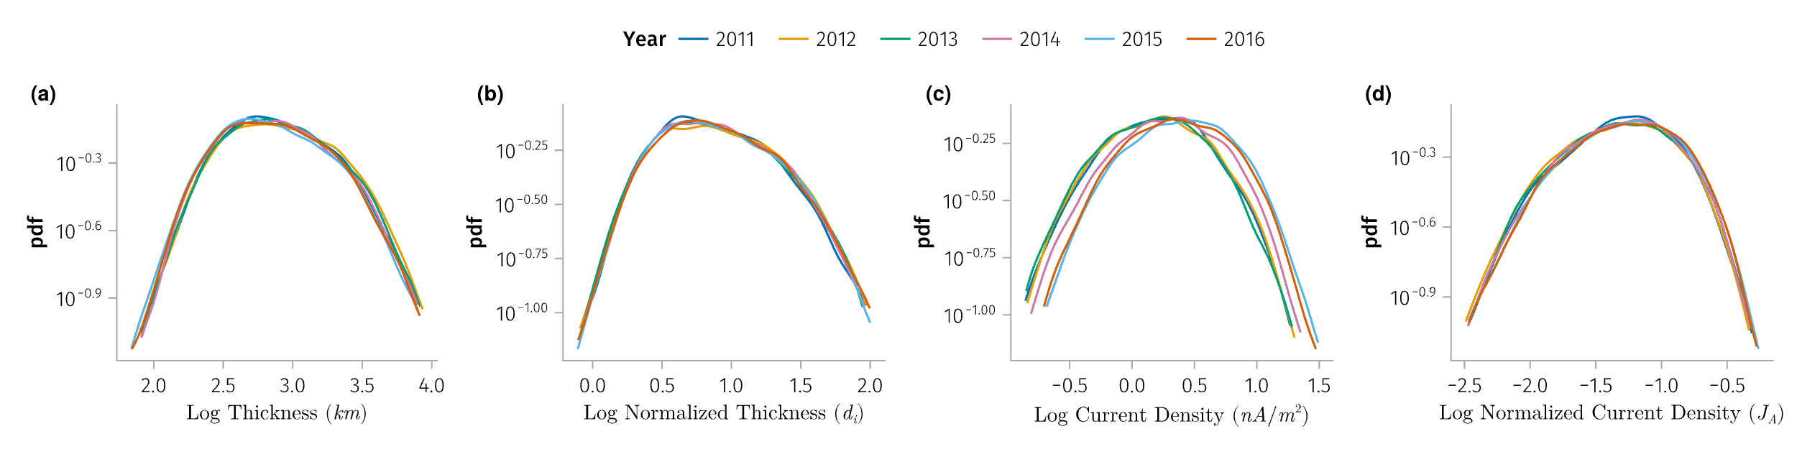
Temporal variations of SWDs
Figure 3: Distribution of various properties of IDs observed by Wind mission grouped by the year of observation. Panel (a) thickness, (b) normalized thickness, (c) current density, (d) normalized current density.

Slide 13
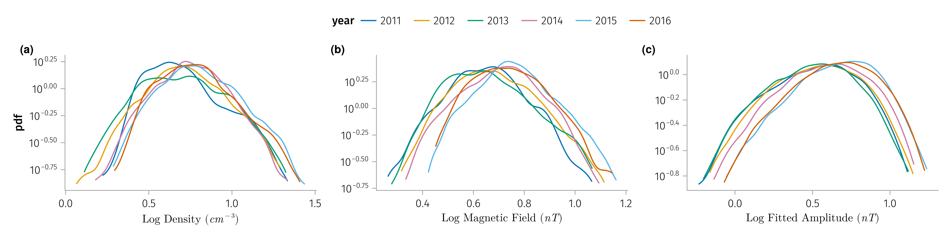
Temporal variations of SWDs
Figure 4: Solar wind parameters associated with the IDs observed by 1AU satellites (Wind, ARTEMIS and STEREO-A) grouped by the year of observation. Panel (a) solar wind density, (b) magnetic field, (c) fitted magnetic field amplitude.

Slide 14
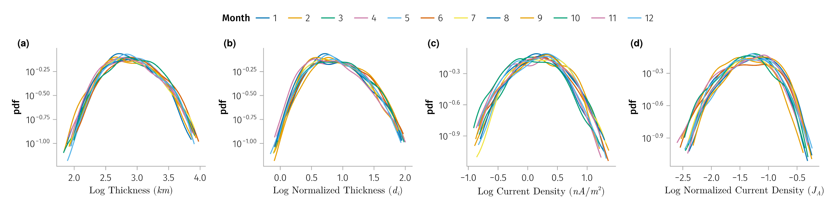
Temporal variations of SWDs
Grouped by month for the year 2013
Notes:
The change in the current density could be explained by the change in the solar wind properties with the solar cycle, as shown in @fig-swParameters. Density and magnetic field asscoiated with the discontinuities increases with the solar cycle approaching the solar minimum, which could lead to the increase of the current density of the discontinuities with fixed normalized current density.

Slide 15
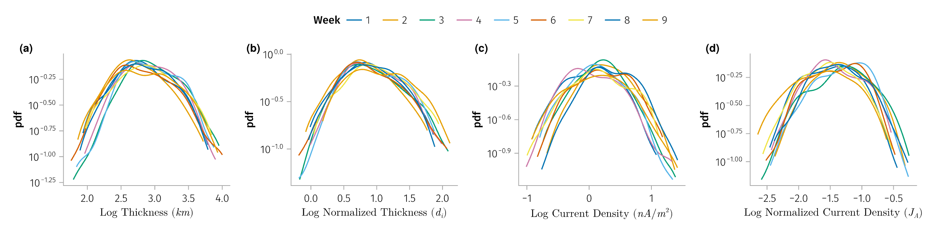
Temporal variations of SWDs
Grouped by week for the first two months of 2013

Slide 16
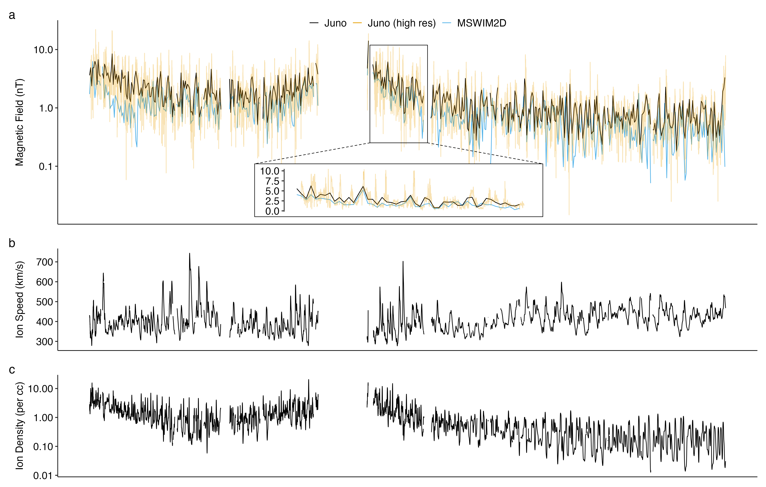
Dataset
Mission | δt(B) | δt(plasma)
Juno | 1 Hz | 1 hour
ARTEMIS | 5 Hz | 0.25 Hz
WIND | 11 Hz | 1 Hz
STEREO | 8 Hz | 1 min
Figure 5:
a, Magnetic field magnitude from MSWIM2D and Juno.
b-c, Plasma speed and density from MSWIM2D model.
Notes:
However, since Juno does not provide direct plasma measurements, we will estimate the spatial scale (thickness) of discontinuities using solar wind speed derived from solar wind propagation models. Specifically, we will employ the Two-Dimensional Outer Heliosphere Solar Wind Modeling (MSWIM2D) (Keebler et al. 2022) to determine the ion bulk velocity (v) and plasma density (n) at Juno’s location. This model, which utilizes the BATSRUS MHD solver, simulates the propagation of solar wind from 1 to 75 astronomical units (AU) in the ecliptic plane, effectively covering the region pertinent to our study. The MSWIM2D model provides output data with an hourly time resolution as shown in Figure 5. The comparison of magnetic field magnitudes from MSWIM2D with those measured by Juno, after averaging to the same time resolution, reveals a strong correlation, confirming the model’s reliability.

Slide 17
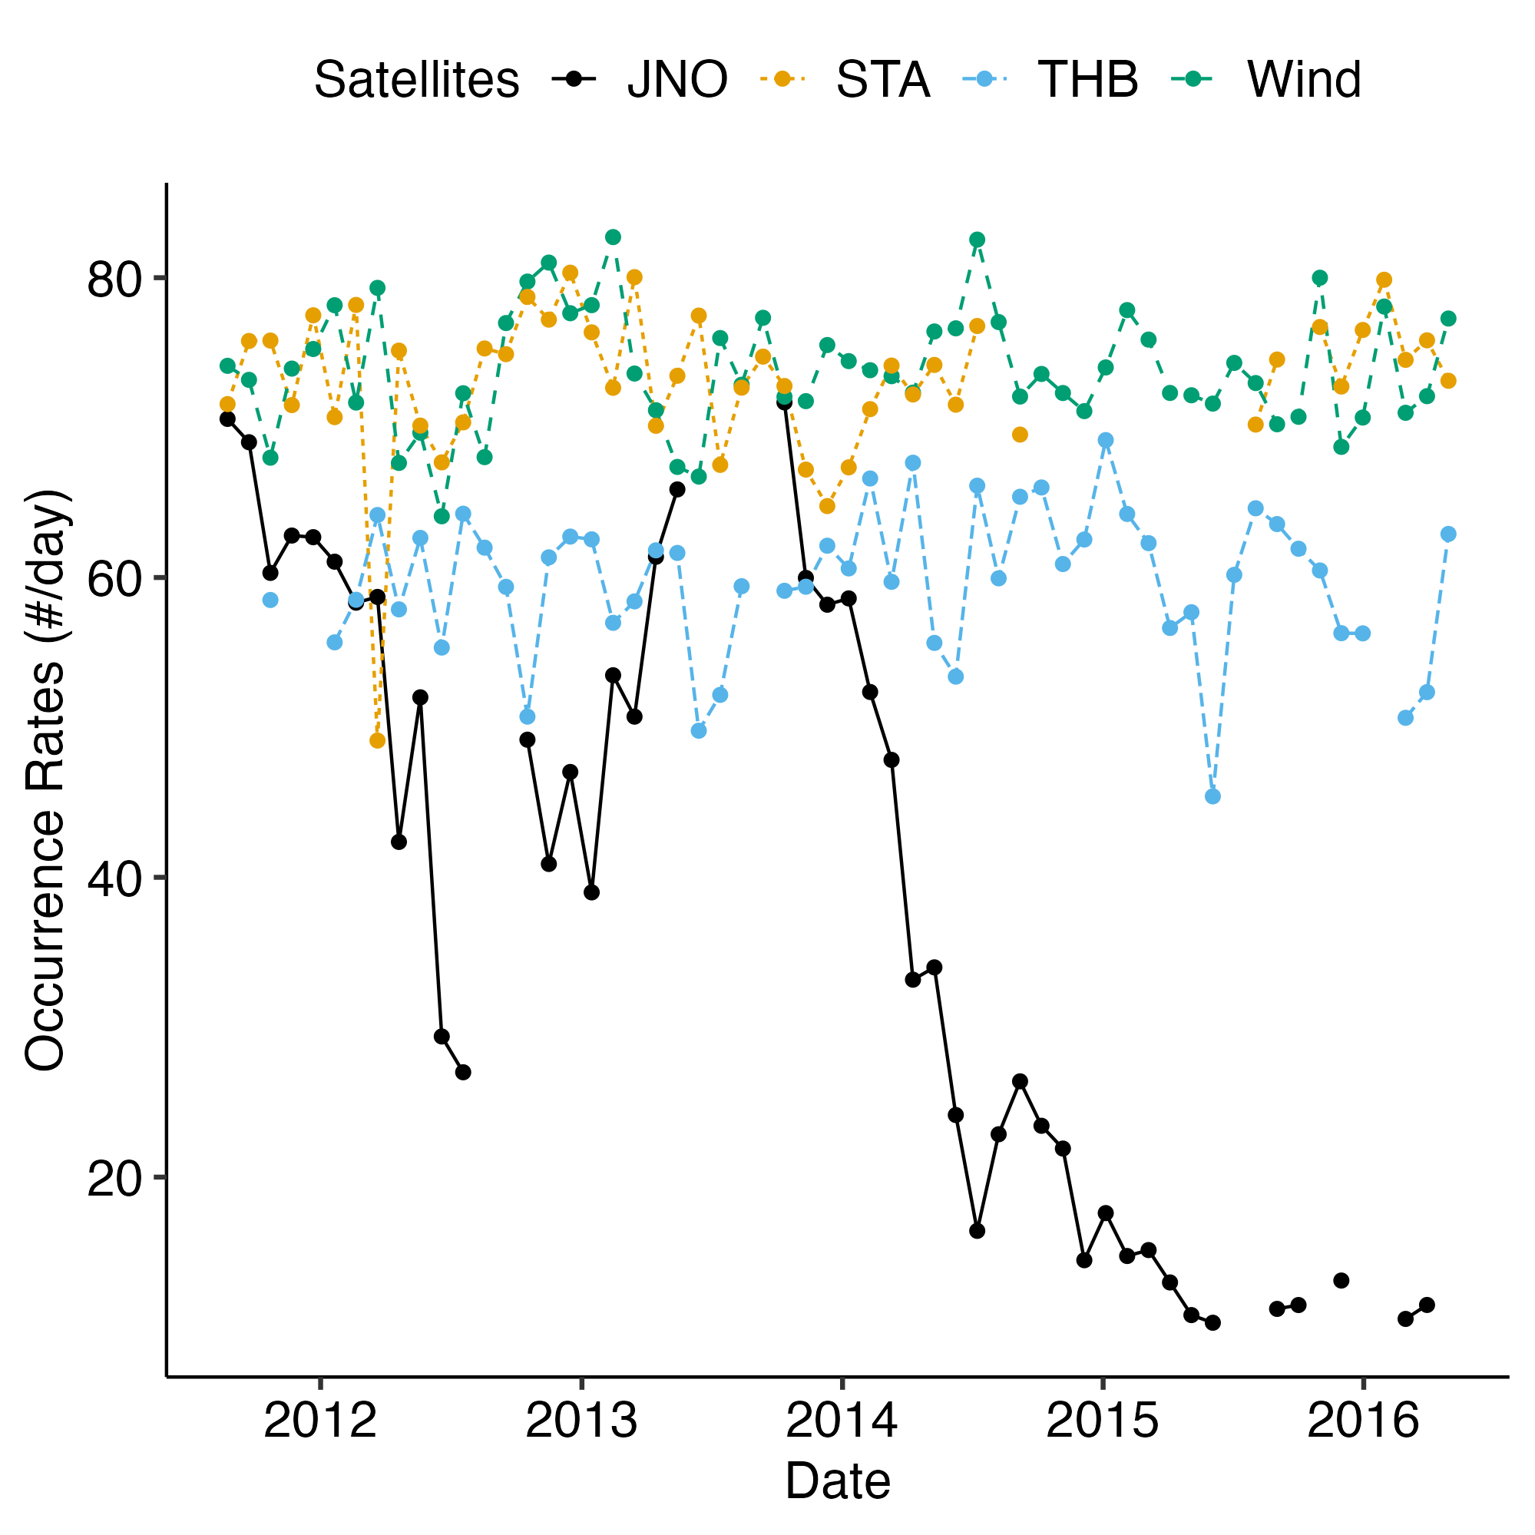
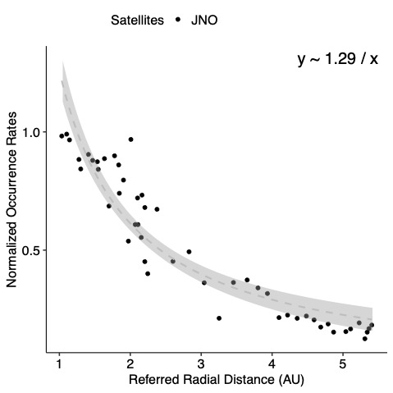
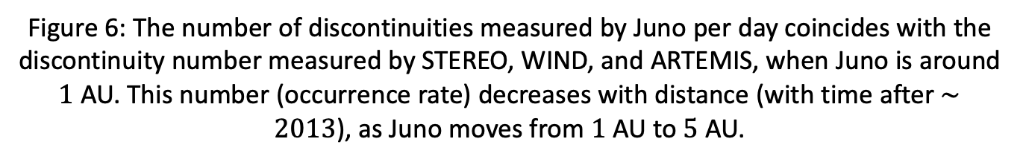
Results - Occurrence rate
Figure 6: The number of discontinuities measured by Juno per day coincides with the discontinuity number measured by STEREO, WIND, and ARTEMIS, when Juno is around $1$ AU. This number (occurrence rate) decreases with distance (with time after $∼2013$), as Juno moves from $1$ AU to $5$ AU.

Slide 18
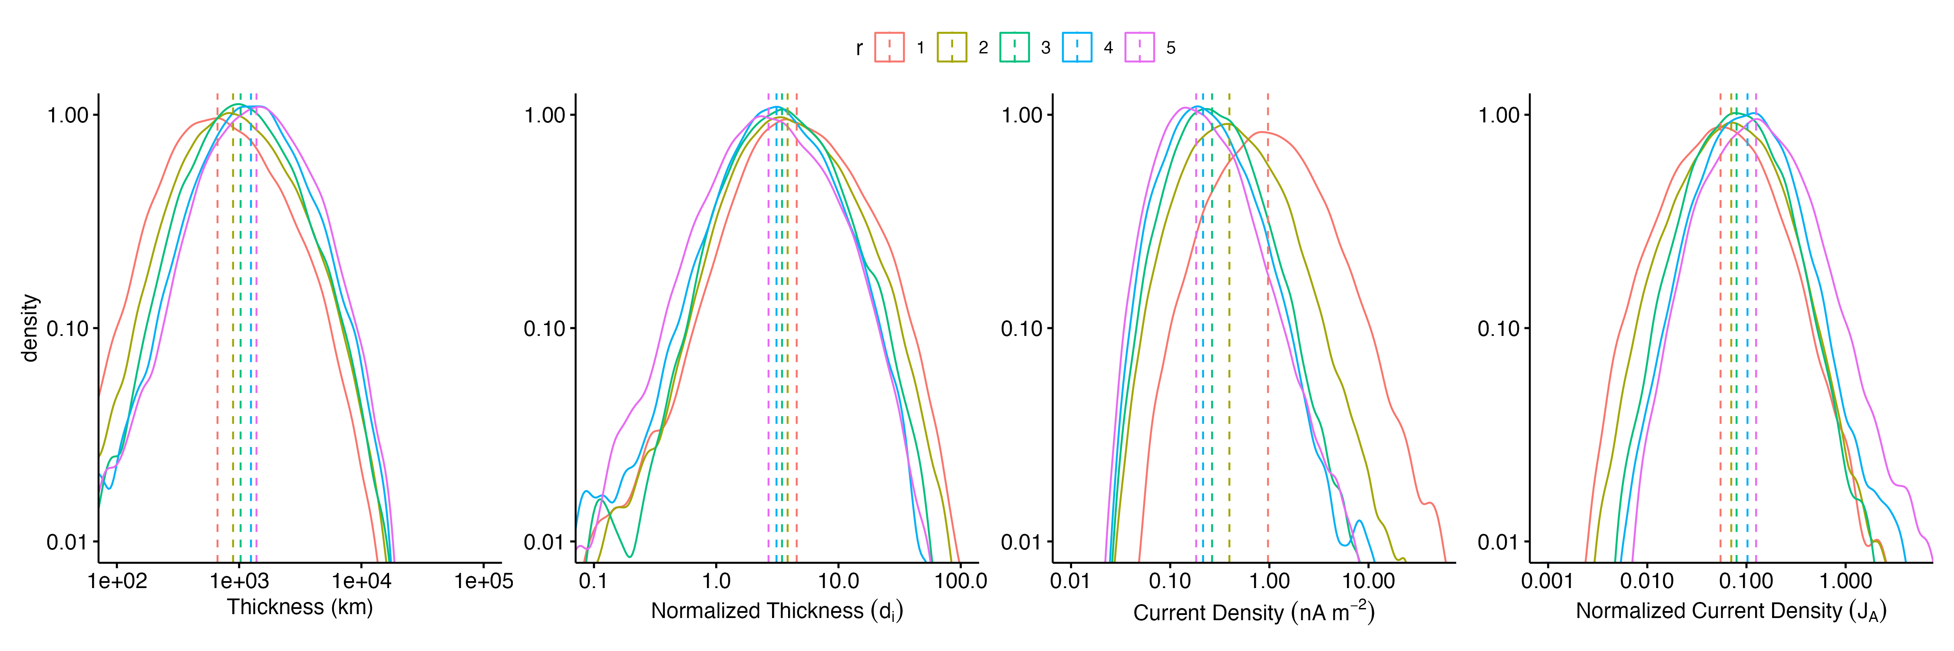
Results - Current density and thickness
Figure 7: Distribution of various properties of IDs observed by Juno grouped by the radial distance from the Sun. Panel (a) thickness, (b) normalized thickness, (c) current density, (d) normalized current density.

Slide 19
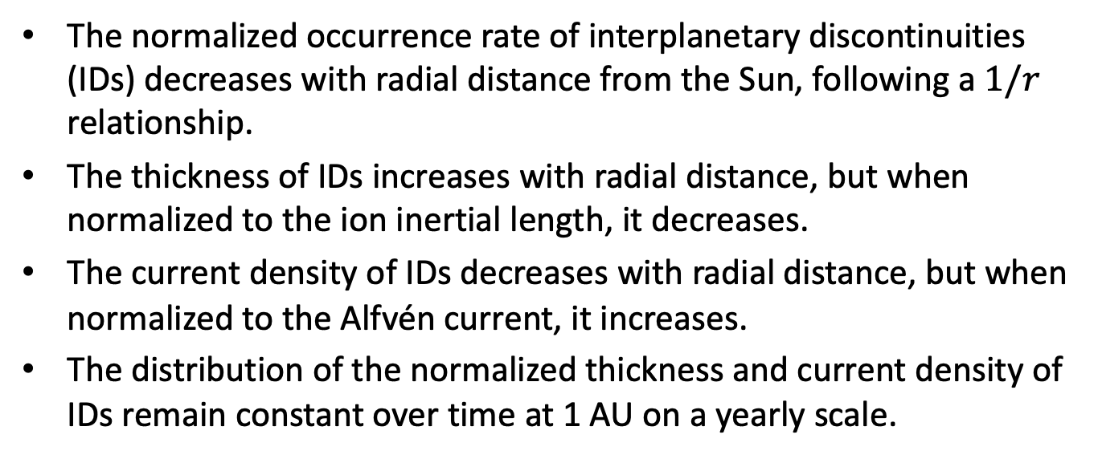
Conclusion
The normalized occurrence rate of interplanetary discontinuities (IDs) decreases with radial distance from the Sun, following a $1/r$ relationship.
The thickness of IDs increases with radial distance, but when normalized to the ion inertial length, it decreases.
The current density of IDs decreases with radial distance, but when normalized to the Alfvén current, it increases.
The distribution of the normalized thickness and current density of IDs remain constant over time at 1 AU on a yearly scale.

Slide 20
Parker Solar Probe Observations Observations in the Inner Heliosphere
Part Two

Slide 21
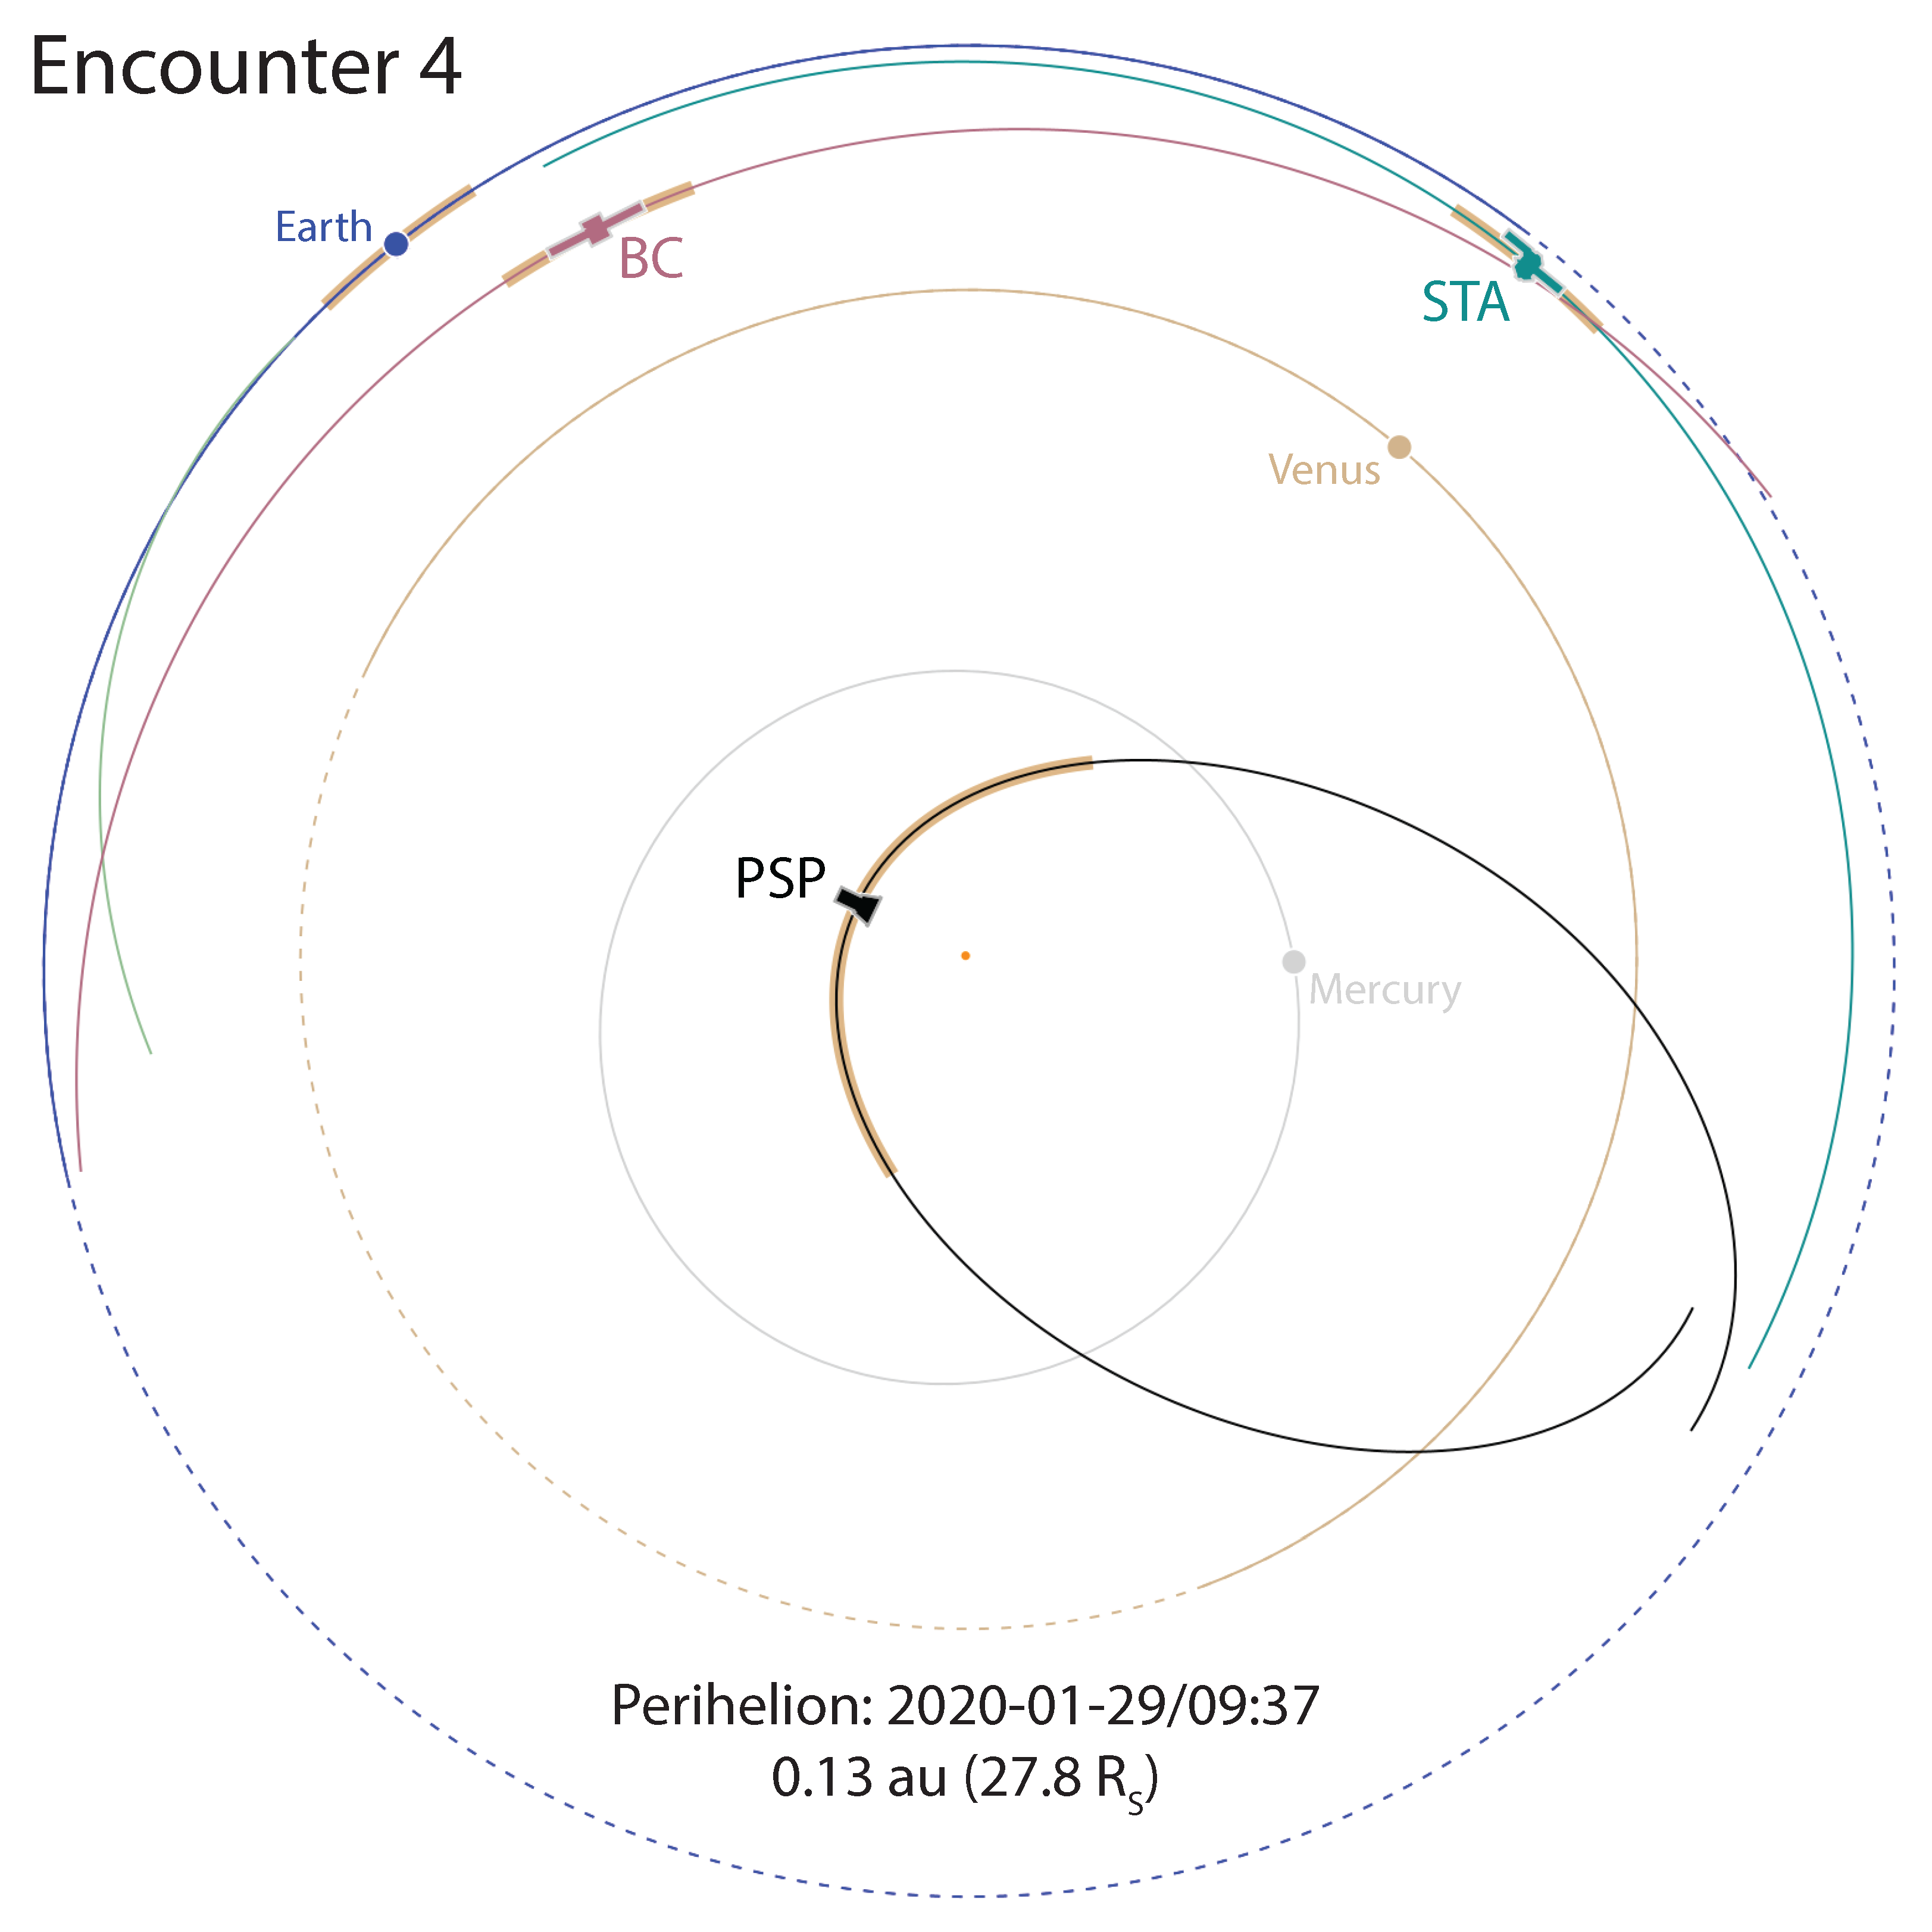
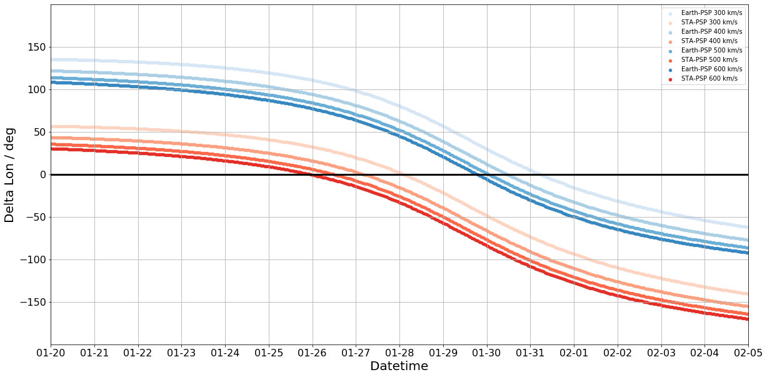
Alignment: orbits
Earth
STEREO-A
Credit: PSP Science Gateway

Slide 22
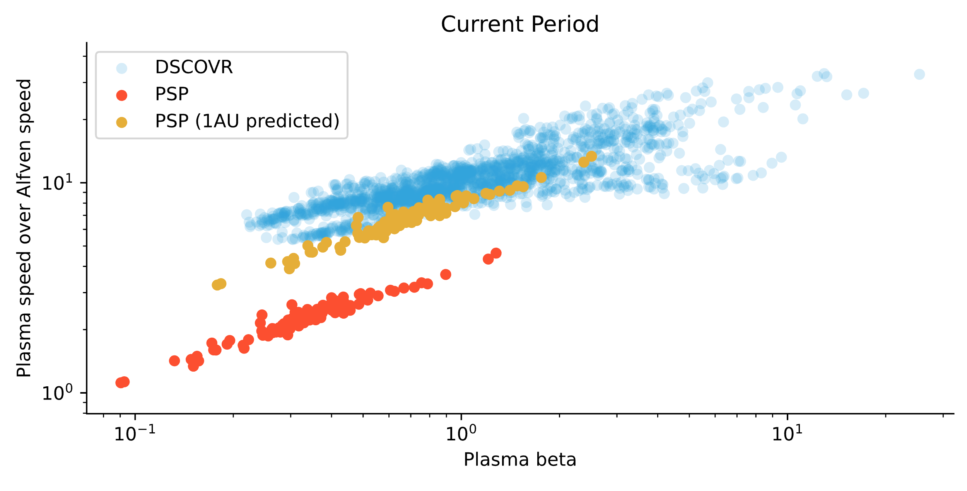
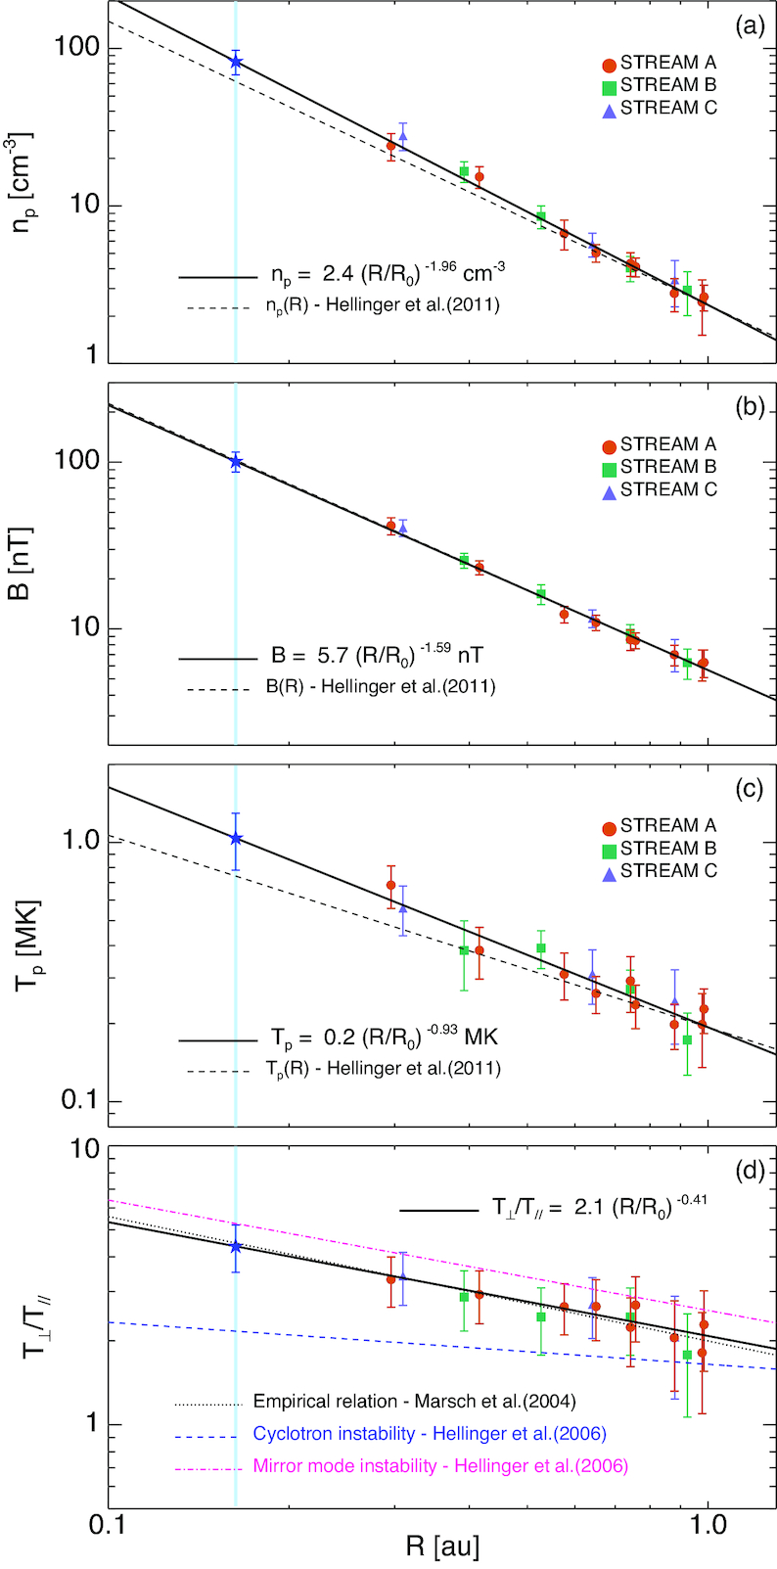
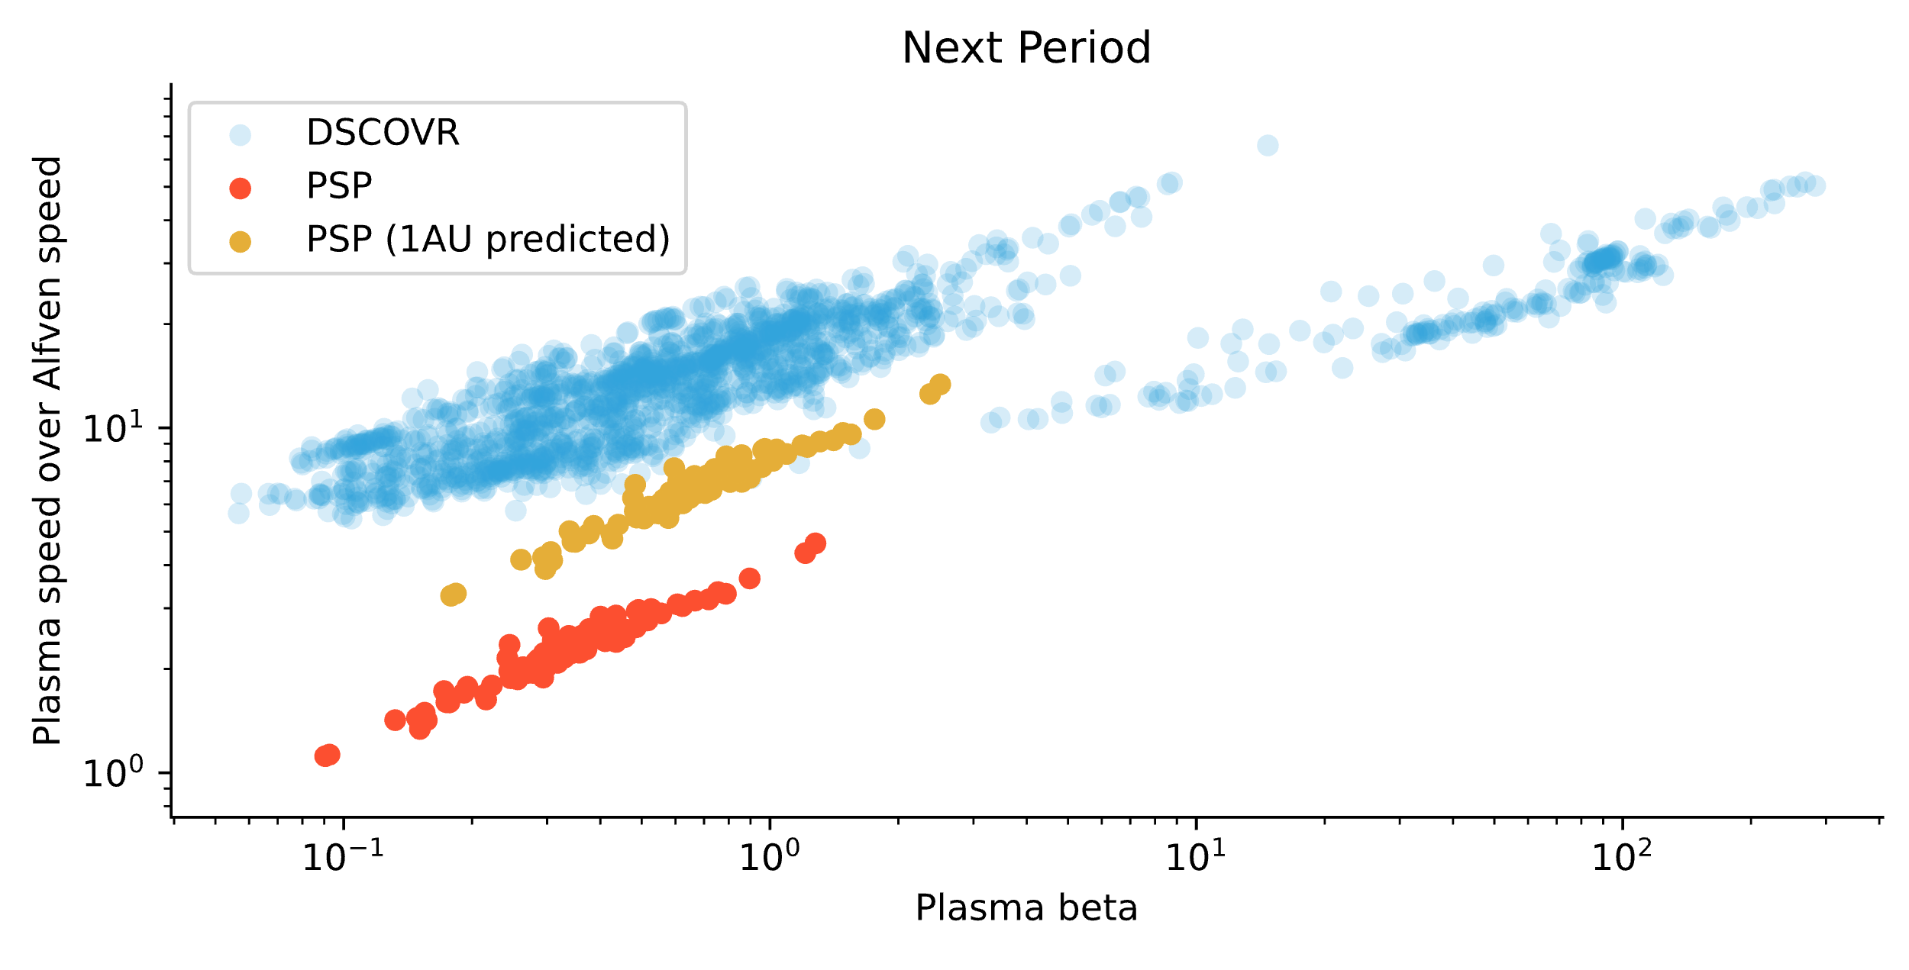
High-speed solar wind radial evolution
Perrone, 2019

Slide 23
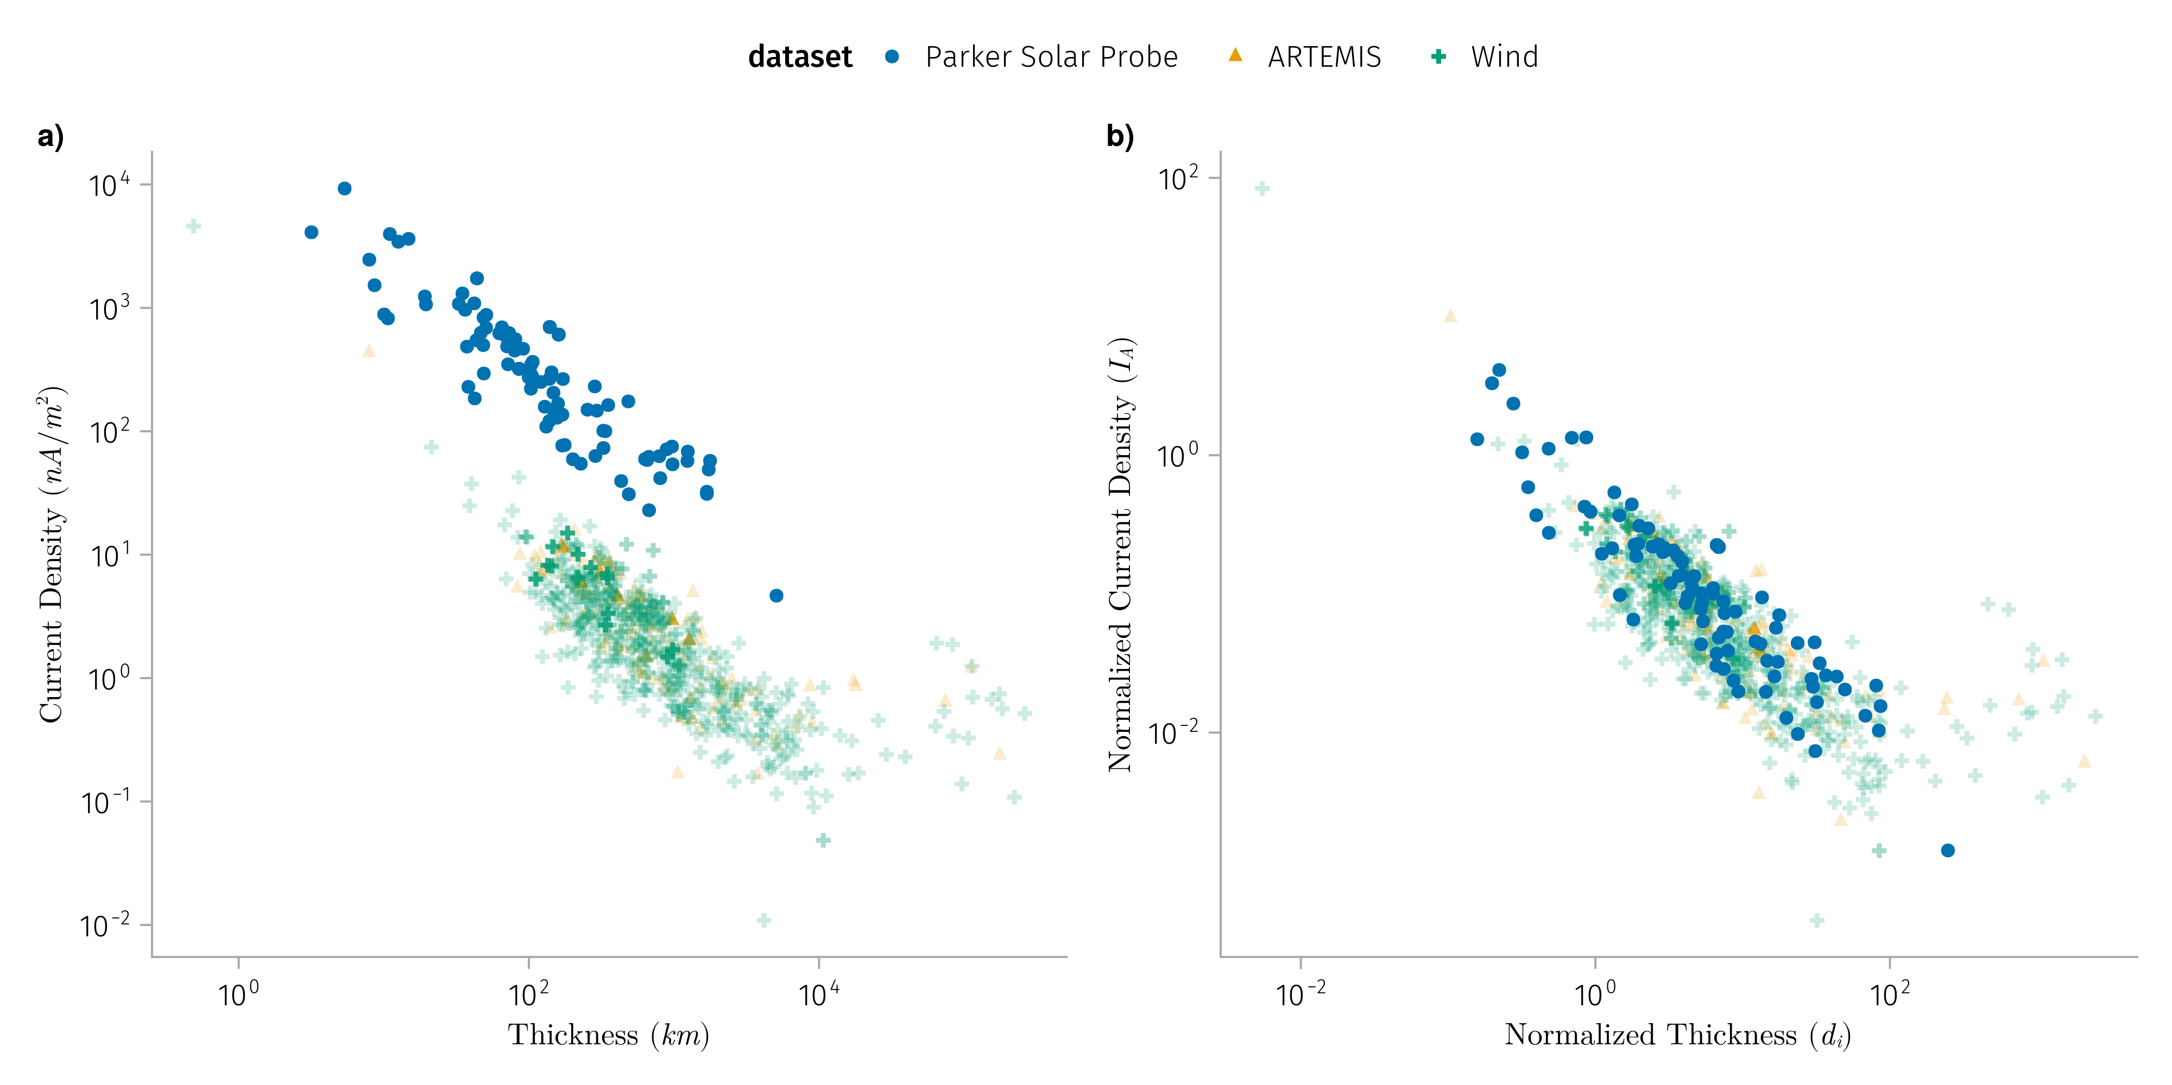
Comparison of discontinuities properties
K1: Normalized discontinuities properties does not vary much with radial distance

Slide 24
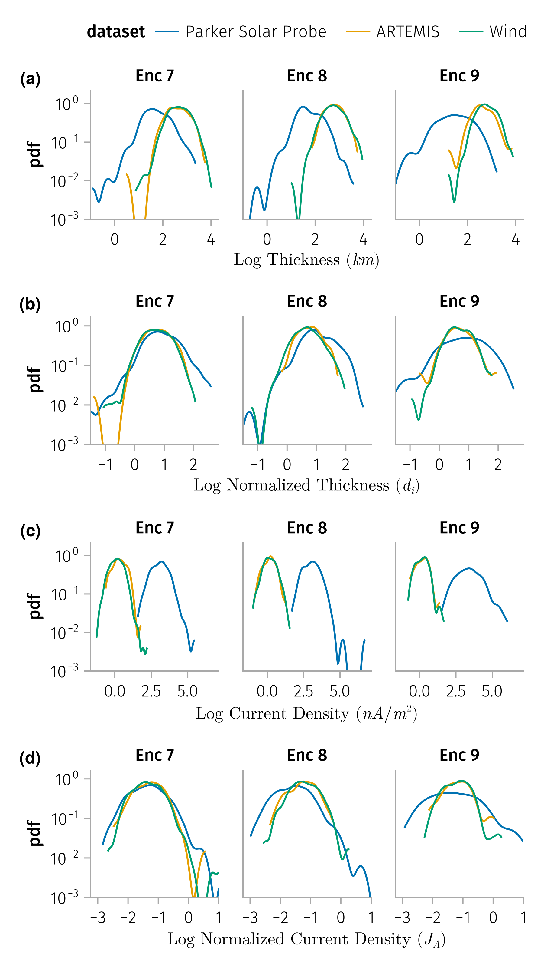
Effect of alignment on discontinuity properties

Slide 25
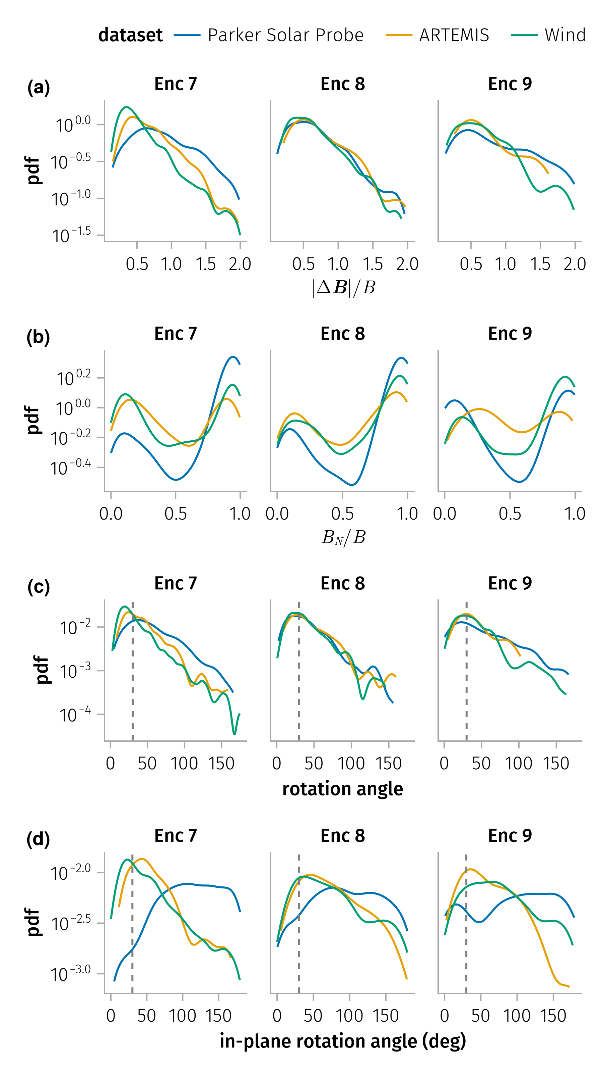
Effect of alignment on discontinuity properties

Slide 26
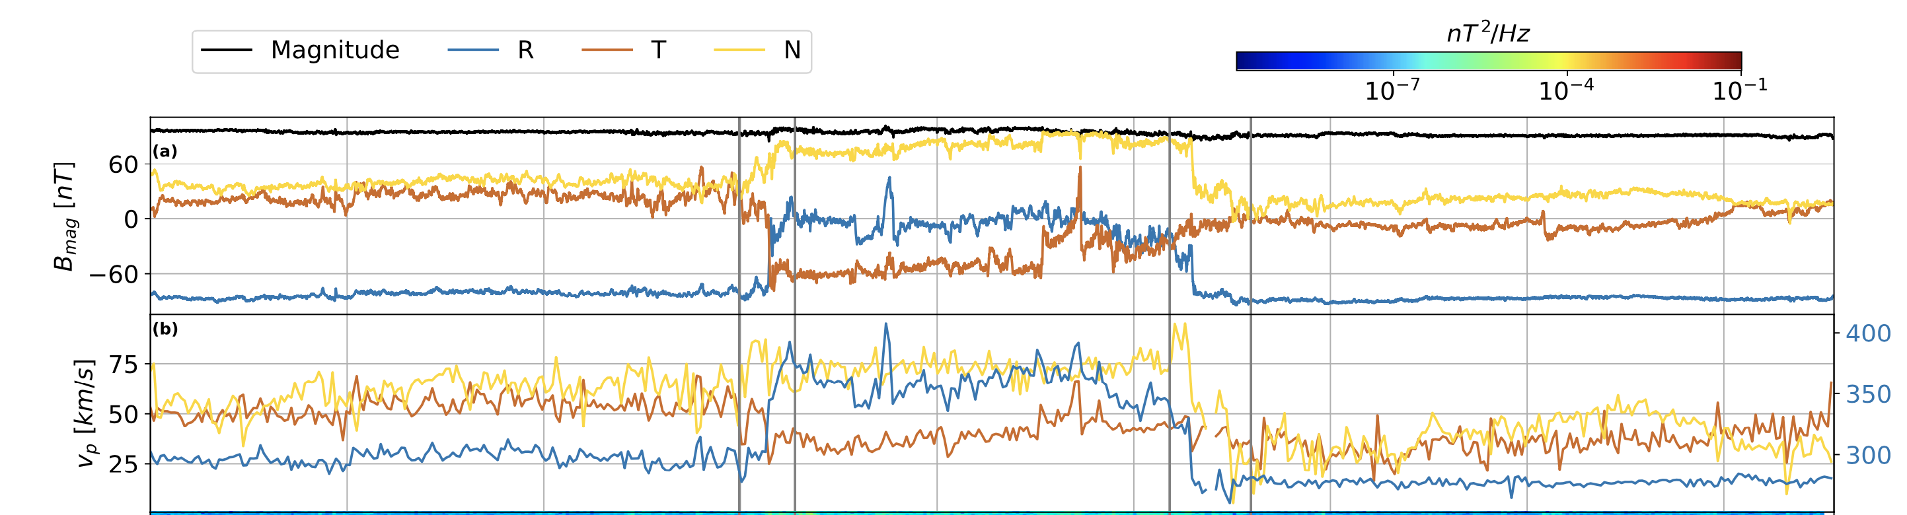
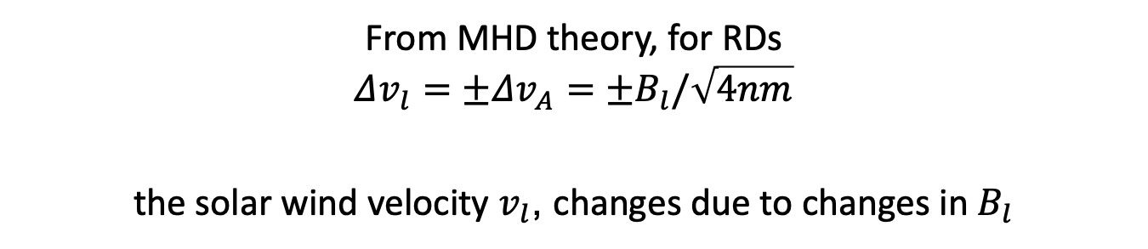
Pressure balance across discontinuities
From MHD theory, for RDs
$$Δv_{l}=±Δv_{A}={±B}_{l}/\sqrt{4nm}$$
the solar wind velocity $v_{l}$, changes due to changes in $B_{l}$
Larosa et al. 2021
Notes:
From MHD theory, conservation of momentum could be reduced to the balance of pressure across the discontinuity for RDs
$$Δv_{l}=±Δv_{A}$$

Slide 27
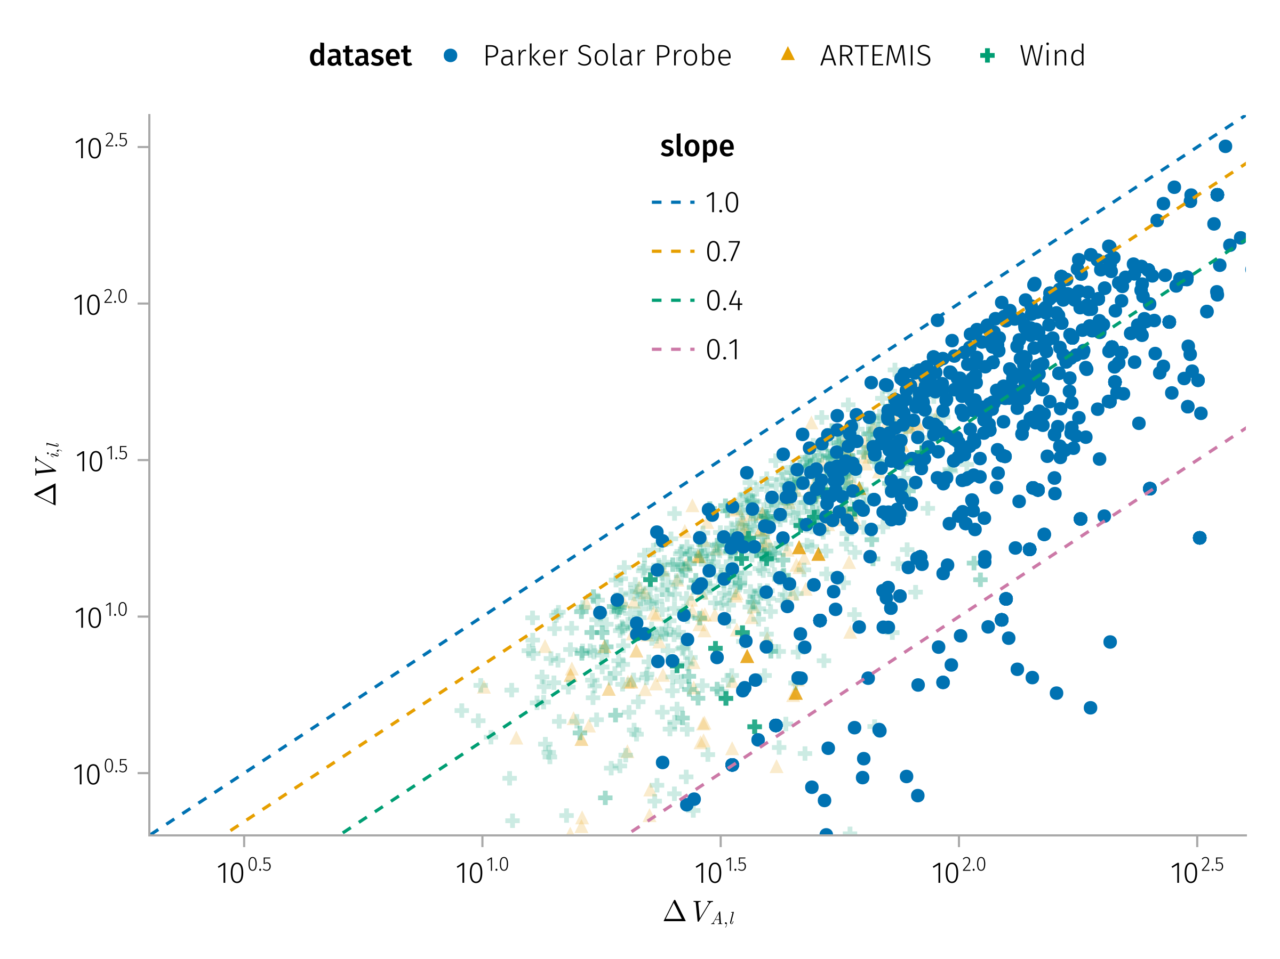
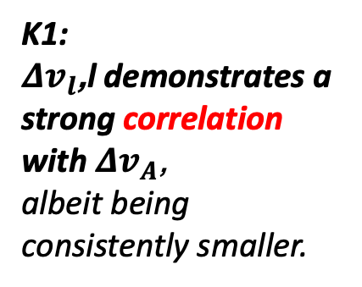
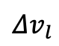
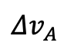
Comparison of Alfven and plasma speed change
K1:
$Δv_{l}$,l demonstrates a strong correlation with $Δv_{A}$,
albeit being consistently smaller.
$$Δv_{l}$$
$$Δv_{A}$$

Slide 28
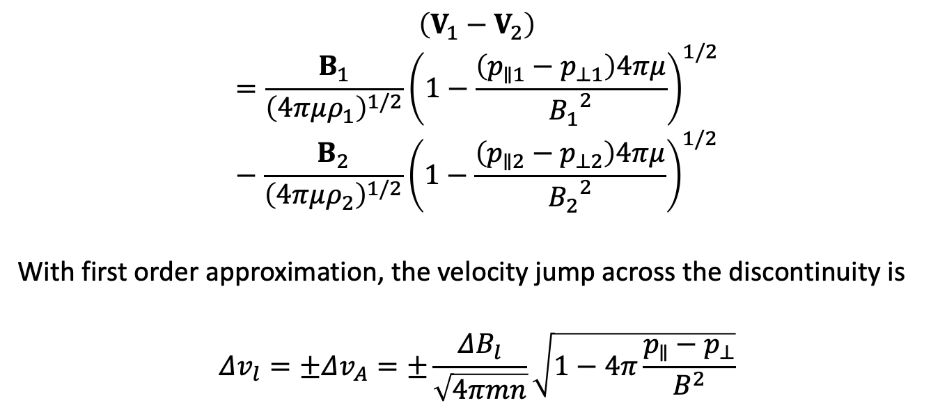
Pressure balance across discontinuities for anisotropic plasma
$$\left(V_{1}−V_{2}\right)=\frac{B_{1}}{{\left(4πμρ_{1}\right)}^{1/2}}{\left(1−\frac{\left(p_{∥1}−p_{⊥1}\right)4πμ}{{B_{1}}^{2}}\right)}^{1/2}−\frac{B_{2}}{{\left(4πμρ_{2}\right)}^{1/2}}{\left(1−\frac{\left(p_{∥2}−p_{⊥2}\right)4πμ}{{B_{2}}^{2}}\right)}^{1/2}$$
With first order approximation, the velocity jump across the discontinuity is
$$Δv_{l}=±Δv_{A}=±\frac{ΔB_{l}}{\sqrt{4πmn}}\sqrt{1−4π\frac{p_{∥}−p_{⊥}}{B^{2}}}$$
Hudson (1970)

Slide 29
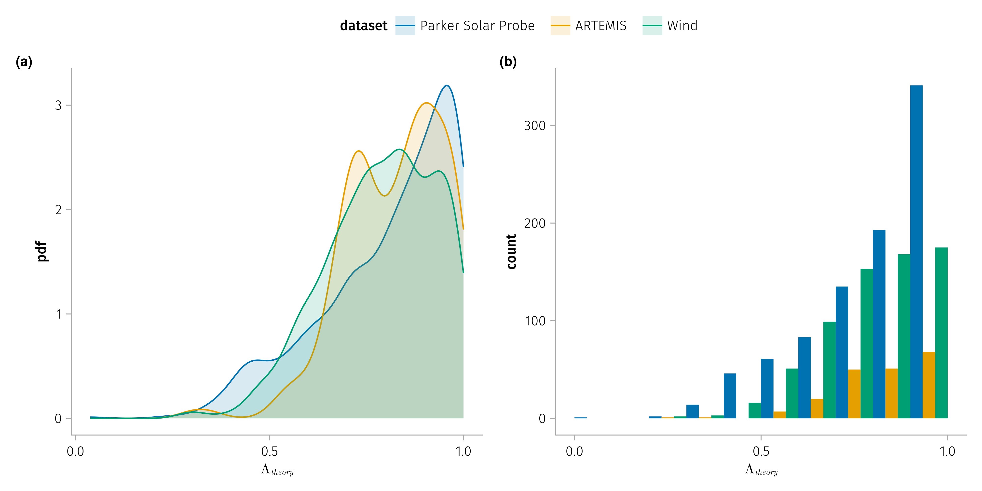
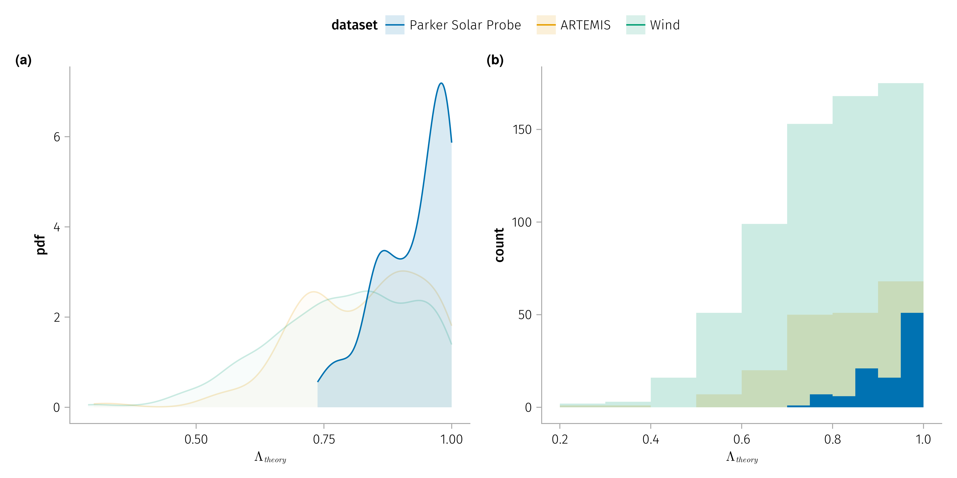
Estimated anisotropy
$Δv_{A}$ includes a factor: pressure anisotropy $Λ=μ\left(P_{∥}−P_{⊥}\right)/B^{2}$

Slide 30
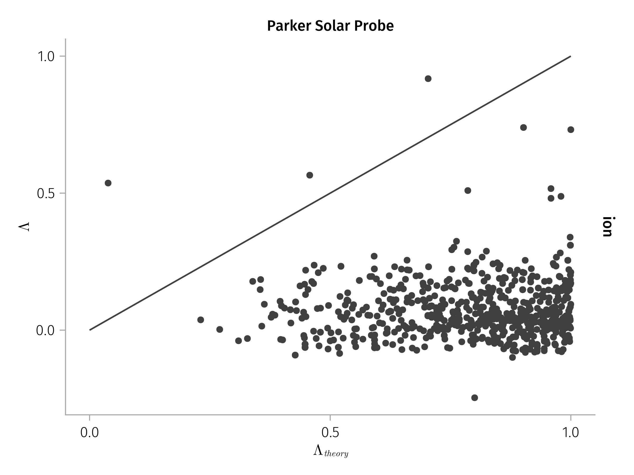
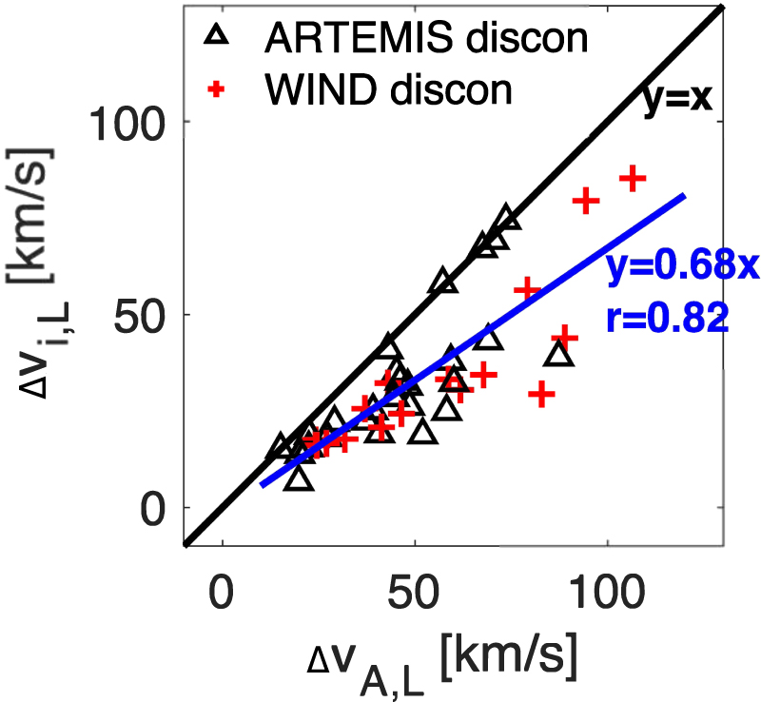
Anisotropy Observations
Notes:
Theory-predicted and directly measured anisotropies diverge for small-scale discontinuities that occur on the timescales of a few to tens of seconds. This likely can be explained by the lack of high-resolution ion anisotropy measurements. Such an inconsistency also suggests that small, kinetic-scale electron and ion characteristics must be investigated to fully understand the nature and origin of solar wind discontinuities.

Slide 31
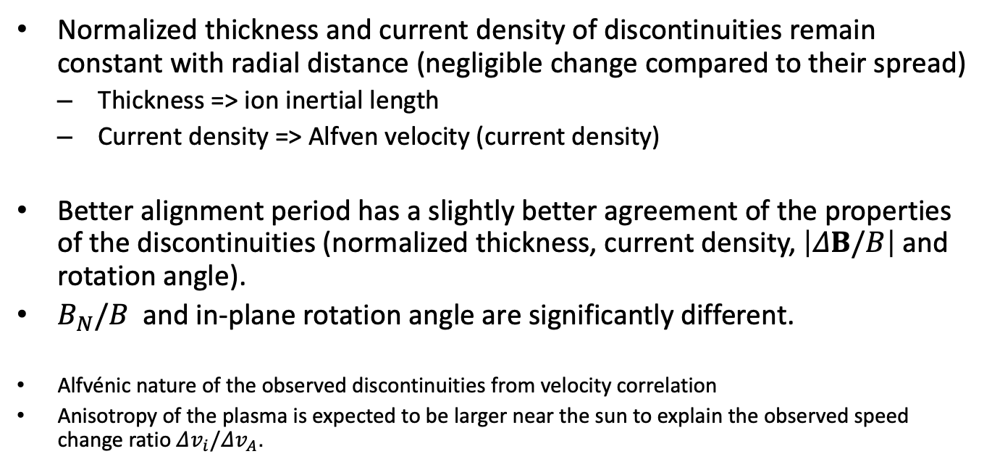
Conclusion
Normalized thickness and current density of discontinuities remain constant with radial distance (negligible change compared to their spread)
Thickness => ion inertial length
Current density => Alfven velocity (current density)
Better alignment period has a slightly better agreement of the properties of the discontinuities (normalized thickness, current density, $\left|ΔB/B\right|$ and rotation angle).
$B_{N}/B$ and in-plane rotation angle are significantly different.
Alfvénic nature of the observed discontinuities from velocity correlation
Anisotropy of the plasma is expected to be larger near the sun to explain the observed speed change ratio $Δv_{i}/Δv_{A}$.

Slide 32
Multifluid model of a one-dimensional steady state force-free current sheet
Part Three

Slide 33
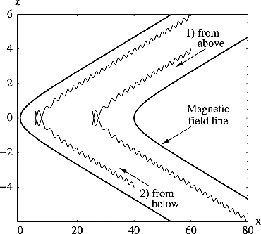
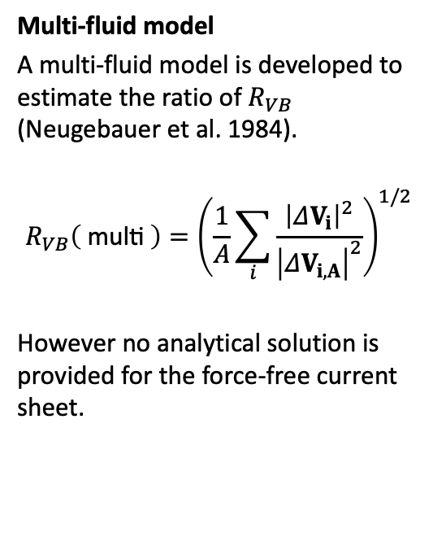
Theory - previous art
Multi-fluid model
A multi-fluid model is developed to estimate the ratio of $R_{VB}$ (Neugebauer et al. 1984).
$$R_{VB}\left( \text{multi} \right)={\left(\frac{1}{A}\sum_{i}^{​}{\frac{{\left|ΔV_{i}\right|}^{2}}{{\left|ΔV_{i,A}\right|}^{2}}}\right)}^{1/2}$$
However no analytical solution is provided for the force-free current sheet.
Ion trajectories in model magnetic field.

Slide 34
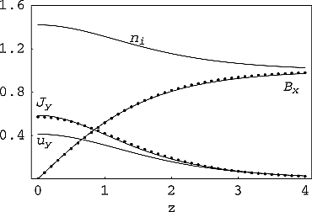
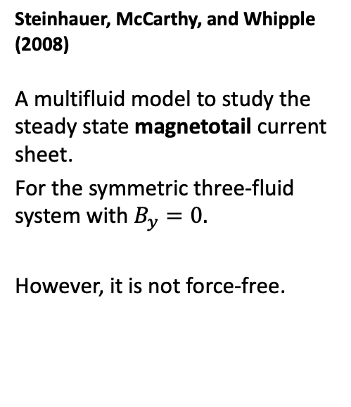
Steinhauer, McCarthy, and Whipple (2008)
A multifluid model to study the steady state magnetotail current sheet.
For the symmetric three-fluid system with $B_{y}=0.$
However, it is not force-free.
Magnetic field, current density, ion density and out-of-plane flow for Bz = 0.1, βe = 0.5, βi = 1. Solid lines are fluid model results and dot symbols are from the Harris sheet solution.

Slide 35

Vlasov equilibrium
A number of Vlasov-Maxwell distribution function have been found to describe force-free current sheet recently
$$\begin{matrix} & \frac{d^{2}A_{x}}{dz^{2}}=−μ_{0}\frac{∂P_{zz}}{∂A_{x}} \\ & \frac{d^{2}A_{y}}{dz^{2}}=−μ_{0}\frac{∂P_{zz}}{∂A_{y}}\end{matrix}$$
no normal field, $B_{z}=0$
Notes:
As has been shown before, the 1D VM equilibrium equations are equivalent to the motion of a pseudoparticle in a conservative pseudopotential, with the pseudopotential being proportional to one of the diagonal components of the plasma pressure tensor.

Slide 36

Theory - previous art

Slide 37
Plasma-Field Equations

Slide 38

Multi-fluid collisionless plasma model in a nutshell
The governing equations for the multi-fluid collisionless plasma model can be expressed in conservation law form as follows:
$$\left(\frac{∂}{∂t}+u_{α}·∇\right)n_{α}=−n_{α}∇·u_{α}$$
$$m_{α}n_{α}\left(\frac{∂}{∂t}+u_{α}·∇\right)u_{α}=−∇·P_{α}+q_{α}n_{α}\left(E+\frac{u_{α}×B}{c}\right)$$
$$∇×B=μ_{0}J$$
$$∇·B=0$$
where $α$ indicates the particle species…

Slide 39


To much, let’s simplify
equilibrium solutions => $\frac{∂}{∂t}=0$
current sheet => a single coordinate, $z$
force-free condition => $B_{x}^{2}+B_{y}^{2}=B_{0}^{2}=\text{const}$
Additionally, we assume
background electron is massless => electrons follow the magnetic field lines $u_{e}×B=0$
ion populations are gyrotropic => eliminating any non-diagonal terms in the pressure tensor
$$\left(\frac{∂}{∂t}+u_{α}·∇\right)n_{α}=−n_{α}∇·u_{α}$$
$$m_{α}n_{α}\left(\frac{∂}{∂t}+u_{α}·∇\right)u_{α}=−∇·P_{α}+q_{α}n_{α}\left(E+\frac{u_{α}×B}{c}\right)$$
$$∇×B=μ_{0}J$$
$$∇·B=0$$
Notes:
magnetic field depends only on a single Cartesian coordinate, $z$

Slide 40

To much, let’s simplify
To further simplify, we employ a dimensionless system by normalizing the variables with their asymptotic values:
magnetic field by $B_{\text{ref}}=B_{z}$
density by $n_{\text{ref}}=n\left(∞\right)$
$$\left(\frac{∂}{∂t}+u_{α}·∇\right)n_{α}=−n_{α}∇·u_{α}$$
$$m_{α}n_{α}\left(\frac{∂}{∂t}+u_{α}·∇\right)u_{α}=−∇·P_{α}+q_{α}n_{α}\left(E+\frac{u_{α}×B}{c}\right)$$
$$∇×B=μ_{0}J$$
$$∇·B=0$$

Slide 41

After all the simplifications
Conservation of fluid mass integrates to a constant parameter $Γ_{α}=n_{α}u_{αz}$;
Gauss’s law gives another constant parameter $B_{z}=\text{const}$;
The momentum equations for each ion species are then given by:
$$\begin{matrix}Γ_{α}\frac{du_{αx}}{dz} & =n_{α}u_{αy}B_{z}−Γ_{α}B_{y} \\ Γ_{α}\frac{du_{αy}}{dz} & =Γ_{α}B_{x}−n_{α}u_{αx}B_{z} \\ Γ_{α}\frac{du_{αz}}{dz} & =−\frac{1}{2}\frac{dp_{α}}{dz}−n_{α}\frac{dφ}{dz}+n_{α}u_{αx}B_{y}−n_{α}u_{αy}B_{x}\end{matrix} \left(2\right)$$
Ampere’s law connects the fields and the flow components:
$$dB_{y}/dz=−J_{x}=−\sum_{α}^{​}{n_{α}}u_{αx}+n_{e}u_{ex}=−nu_{x}+Γ_{e}B_{x}/B_{z} \left(3\right)$$
$$dB_{x}/dz=J_{y}=\sum_{α}^{​}{n_{α}}u_{αy}−n_{e}u_{ey}=nu_{y}−Γ_{e}B_{y}/B_{z} \left(4\right)$$

Slide 42

This is a system of $3N+2$ equations for $4N+2$ unknown dependent variables: $B_{x}$, $B_{y}$, and $N$ each of $n$, $p$ $u_{x}$, and $u_{y}$.
We are interested in solutions with $B_{x}^{2}+B_{y}^{2}=B_{0}^{2}=const$ (force-free current sheet). From Ampere’s law (Equation 2) and (Equation 3), we have:
$$n\left(u_{x}B_{y}−u_{y}B_{x}\right)=0$$
From first two momentum equations, we have:
$$u_{αx}^{2}+u_{αy}^{2}=const$$
Definition 1 Force-free condition let us express the magnetic field and velocity in terms of the angle $θ$:
$$B_{x}=B_{0}cosθ, B_{y}=B_{0}sinθ$$
$$u_{1x}=u_{1}cosθ_{1}, u_{1y}=u_{1}sinθ_{1}$$

Slide 43


The first momentum equation (Equation 2) after substituting the above expression becomes:
$$−u_{α}sinθ_{α}θ_{α}′=n_{α}u_{α}sinθ_{α}B_{z}/Γ_{α}−B_{0}sinθ$$
$$⇒θ_{α}′=−\frac{n_{α}B_{z}}{Γ_{α}}+\frac{B_{0}}{u_{α}} \left(6\right)$$
Note that $θ_{α},n_{α}$ are dependent variables, and $u_{α},B_{0},B_{z},Γ_{α}$ are constants determined by the system.
So given the profile of $n_{α}$, we could solve the above equation to get the profile of $θ_{α}$, thus the profile of $u_{α}$.
The Ampere’s law (Equation 4) become:
$$⇒θ′=−\frac{∑n_{α}u_{α}}{B_{0}}+\frac{Γ_{e}}{B_{z}} \left(8\right)$$
The plasma bulk velocity is related to one specific species
$$nu≡∑n_{α}u_{α}=B_{0}\left(\frac{Γ_{e}}{B_{z}}+\frac{n_{α}B_{z}}{Γ_{α}}−\frac{B_{0}}{u_{α}}\right)$$
Notes:
The above equation relates the rotation angle $θ$ to the plasma bulk velocity $nu≡∑n_{α}u_{α}$. By equating the above two equations of $θ′$, we could get a equation relating the plasma bulk velocity to one specific species

Slide 44

Solutions
The system $S$ could be fully determined provided $n\left(z\right)$ profiles.
$$S=S\left(z;n\left(z\right)\right)$$
Assuming density profile
$$n_{1}\left(z\right)→n_{1}\left(∞\right)+\frac{κΓ_{1}}{1+{\left(z/L\right)}^{2}}$$
Solving analytically, we have the rotation angle profile as
$$θ\left(z\right)→\frac{π}{2}−κLB_{z}\tan^{−1}\left(\frac{z}{L}\right)$$

Slide 45


Beutiful moment - solutions
In dimensionless form
$$\begin{matrix} & B_{x}\left(z\right)=B_{0}sin\left(κLB_{z}\tan^{−1}\left(\frac{z}{L}\right)\right) \\ & B_{y}\left(z\right)=B_{0}cos\left(κLB_{z}\tan^{−1}\left(\frac{z}{L}\right)\right) \\ & n\left(z\right)=n\left(∞\right)+\frac{κ\sum_{α}^{​}{Γ_{α}}}{1+{\left(z/L\right)}^{2}} \\ & J_{x}\left(z\right)=\frac{κB_{0}B_{z}}{1+{\left(z/L\right)}^{2}}sin\left(κLB_{z}\tan^{−1}\left(\frac{z}{L}\right)\right) \\ & J_{y}\left(z\right)=\frac{κB_{0}B_{z}}{1+{\left(z/L\right)}^{2}}cos\left(κLB_{z}\tan^{−1}\left(\frac{z}{L}\right)\right)\end{matrix}$$
In physical units
$$\begin{matrix} & B_{x}\left(z\right)=B_{0}sin\left(\frac{κL}{d_{i}}\tan^{−1}\left(\frac{z}{L}\right)\right) \\ & B_{y}\left(z\right)=B_{0}cos\left(\frac{κL}{d_{i}}\tan^{−1}\left(\frac{z}{L}\right)\right) \\ & n\left(z\right)=n_{∞}+\frac{κ}{V_{A}}\frac{\sum_{α}^{​}{Γ_{α}}}{1+{\left(z/L\right)}^{2}} \\ & J_{x}\left(z\right)=\frac{κB_{0}}{μ_{0}d_{i}}\frac{1}{1+{\left(z/L\right)}^{2}}sin\left(\frac{κL}{d_{i}}\tan^{−1}\left(\frac{z}{L}\right)\right) \\ & J_{y}\left(z\right)=\frac{κB_{0}}{μ_{0}d_{i}}\frac{1}{1+{\left(z/L\right)}^{2}}cos\left(\frac{κL}{d_{i}}\tan^{−1}\left(\frac{z}{L}\right)\right)\end{matrix}$$

Slide 46


Symmetric case
$$\begin{matrix} & B_{x}\left(z\right)=B_{0}sin\left(κLB_{z}\tan^{−1}\left(\frac{z}{L}\right)\right) \\ & \\ & n\left(z\right)=n\left(∞\right)+\frac{κ\sum_{α}^{​}{Γ_{α}}}{1+{\left(z/L\right)}^{2}} \\ & J_{x}\left(z\right)=\frac{κB_{0}B_{z}}{1+{\left(z/L\right)}^{2}}sin\left(κLB_{z}\tan^{−1}\left(\frac{z}{L}\right)\right) \\ & \end{matrix}$$

Slide 47

Asymmetric case
$$\begin{matrix} & B_{x}\left(z\right)=B_{0}sin\left(κLB_{z}\tan^{−1}\left(\frac{z}{L}\right)\right) \\ & \\ & n\left(z\right)=n\left(∞\right)+\frac{κ\sum_{α}^{​}{Γ_{α}}}{1+{\left(z/L\right)}^{2}} \\ & J_{x}\left(z\right)=\frac{κB_{0}B_{z}}{1+{\left(z/L\right)}^{2}}sin\left(κLB_{z}\tan^{−1}\left(\frac{z}{L}\right)\right) \\ & \end{matrix}$$

Slide 48

Velocity profile - effect of multiple fluids

Slide 49

Alfvénicity

Slide 50

Asymptotic velocity

Slide 51


Conclusion
We have developed a multi-fluid force-free current sheet model with
non-zero normal magnetic field and
non-zero asymptotic density
$$\begin{matrix} & B_{x}\left(z\right)=B_{0}sin\left(\frac{κL}{d_{i}}\tan^{−1}\left(\frac{z}{L}\right)\right) \\ & B_{y}\left(z\right)=B_{0}cos\left(\frac{κL}{d_{i}}\tan^{−1}\left(\frac{z}{L}\right)\right) \\ & n\left(z\right)=n_{∞}+\frac{κ}{V_{A}}\frac{\sum_{α}^{​}{Γ_{α}}}{1+{\left(z/L\right)}^{2}} \\ & J_{x}\left(z\right)=\frac{κB_{0}}{μ_{0}d_{i}}\frac{1}{1+{\left(z/L\right)}^{2}}sin\left(\frac{κL}{d_{i}}\tan^{−1}\left(\frac{z}{L}\right)\right) \\ & J_{y}\left(z\right)=\frac{κB_{0}}{μ_{0}d_{i}}\frac{1}{1+{\left(z/L\right)}^{2}}cos\left(\frac{κL}{d_{i}}\tan^{−1}\left(\frac{z}{L}\right)\right)\end{matrix}$$

Slide 52
Ion scattering by solar wind discontinuities
Part Three

Slide 53

Introduction
The transport of energetic particles within the heliosphere is significantly influenced by the turbulent magnetic field present in the solar wind.
However, this turbulence should not be regarded merely as a collection of random magnetic field fluctuations. Instead, the nonlinear energy cascade process results in the formation of coherent structures.
These coherent structures have been shown to act as efficient particle scatterers in non-collisional plasmas (Artemyev et al. 2020).
Moraal (2013)

Slide 54

Test particle simulations
$$B=B_{0}\left(cosθ e_{z}+sinθ\left(sinφ\left(z\right) e_{z}+cosφ\left(z\right) e_{y}\right)\right)$$
with $φ\left(z\right)=βtanh\left(z\right)$
Dimensionless form of the motion equation:
$$\frac{d\left(γv\right)}{dt}=v×B, \frac{dr}{dt}=v$$
$B→B/B_{0}$ : background magnetic field magnitude
$r→r/L$ : discontinuity $L$
$t→t/Ω_{0}$ : gyro-period
$v→v/v_{0}$ : characteristic velocity $v_{0}=Ω_{0}L$

Slide 55


Parameters
$Δ\left|B\right|/\left|B\right|>0.05$ or $ω>60°$
(Liu et al. 2023)
The most probable values in the 3D distribution are a characteristic velocity ($v_{0}$) of approximately 250 km/s, a in-plane rotation angle ($ω_{in}$) about 90 degrees, and an azimuthal angle ($θ$) of around 85 degrees.

Slide 56

Examples of Pitch angle scattering

Slide 57

Examples of transition matrix

Slide 58


Pitch angle scattering by typical discontinuity
$$ω_{in}\sim 90\text{°}$$
$$θ \sim 85\text{°}$$

Slide 59

Transition matrix for 100 keV particles

Slide 60

Transition matrix for different particle energies

Slide 61

Pitch angle scattering by multiple discontinuities

Slide 62
Conclusion
Solar wind discontinuities are important coherent structures in the solar wind that can effectively scatter energetic ions.
Multiple pitch angle scattering would regularize magnetic moments distribution.

Slide 63
References
Hudson, P. D. 1970. “Discontinuities in an Anisotropic Plasma and Their Identification in the Solar Wind.” Planetary and Space Science 18 (11): 1611–22. https://doi.org/10.1016/0032-0633(70)90036-X.
Perrone, Denise, D Stansby, T S Horbury, and L Matteini. 2019. “Radial Evolution of the Solar Wind in Pure High-Speed Streams: HELIOS Revised Observations.” Monthly Notices of the Royal Astronomical Society 483 (3): 3730–37. https://doi.org/10.1093/mnras/sty3348.

